Slide 1
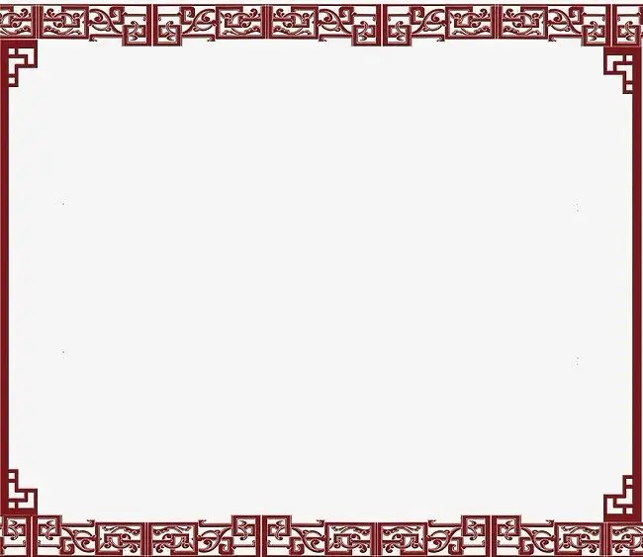
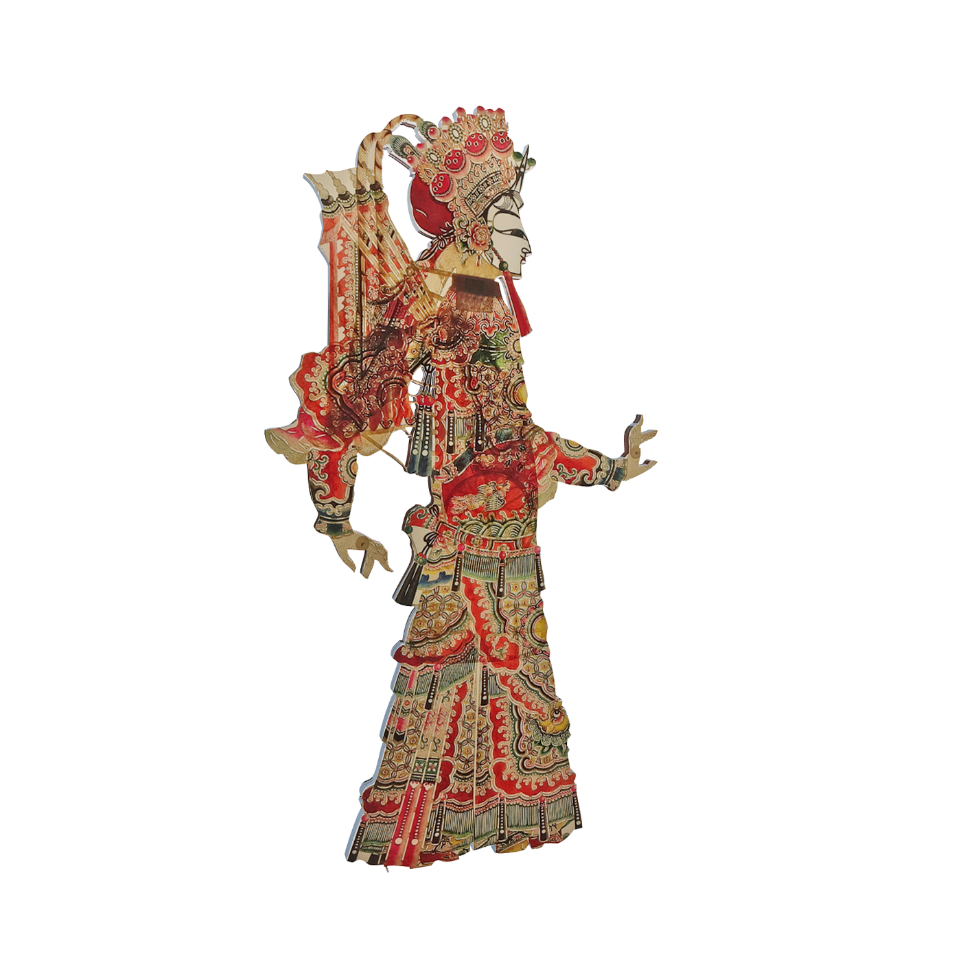
Shadow Puppet Plays
张家港市外国语学校北区 展丹凤

Slide 2
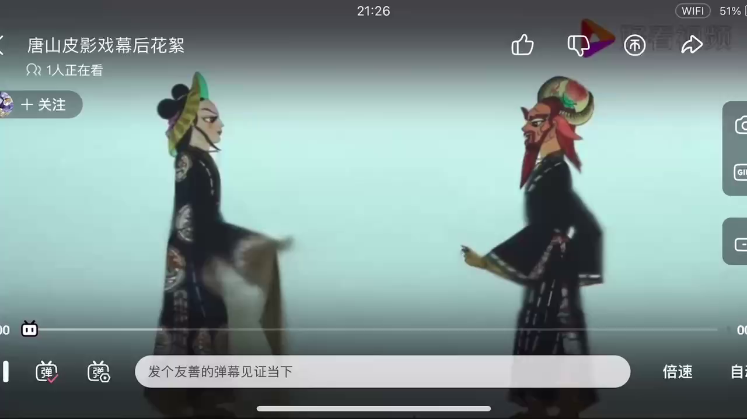

Slide 3
[ˈʃædəʊ]
[ˈpʌpɪt]
Shadow Puppet Plays
?
张家港市外国语学校北区 展丹凤

Slide 4
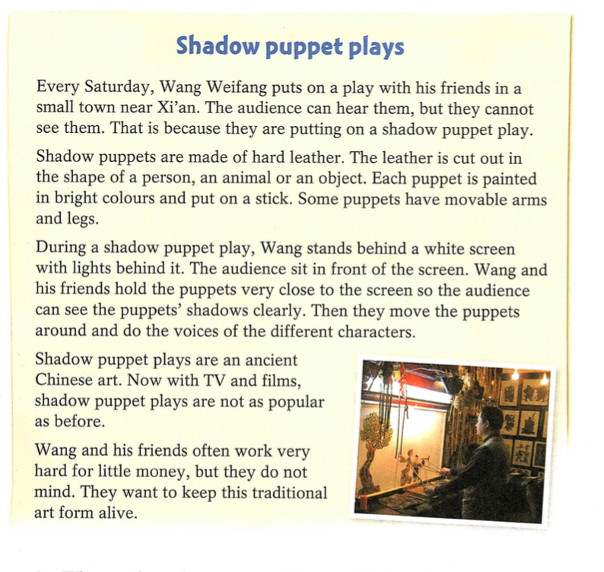
Fast reading
What’s the main idea of each paragraph?
Para 1
1
An introduction
__________________________
2
Para 2
How to make shadow puppets
__________________________
3
Para 3
How to put on a shadow puppet play
__________________________
Para 4
4
The present situation(现状)
__________________________
5
Para 5
Wang Weifang's opinion
__________________________

Slide 5
Careful reading
Para 1 An introduction
[ˈɔːdiəns]
Why is Xi’an mentioned?
Why can’t the audience see Wang and his friends?

Slide 6
Careful reading
Para 2
Para 2 How to make shadow puppets
Please introduce how to make shadow puppets in your own words.
materials & tools
hard leather
scissors
paint
sticks
the making process(制作过程)
be chosen
be cut out
be painted
be put on
Hard leather should be chosen.
[ˈtʃəʊzn]
passive voice (被动语态)
be + P.P (过去分词)

Slide 7
Further thinking
[ˈmu:vəbl]
Why does the writer choose the three words?

Slide 8
Careful reading
Para 3 How to put on a shadow puppet play
props(道具)
shadow puppets
a white screen
lights
Steps to put on a play
stand behind a white screen
hold the puppets close to the screen
move the puppets around
do the voices of different characters
[ˈkærəktə(r)]

Slide 9
Careful reading
Para 3 How to put on a shadow puppet play
Please introduce how to put on a shadow puppet play in your own words.
props(道具)
shadow puppets
a white screen
lights
Steps to put on a play
stand behind ...
hold ... close to ...
move ... around
do the voices of ...

Slide 10
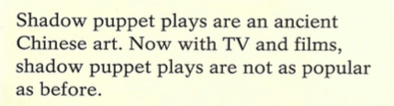
Careful reading
Para 4
Para 4 The present situation(现状)
Discussion
Why are shadow puppet plays not as popular as before?

Slide 11
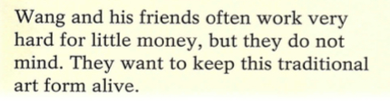
Para 5
Careful reading
Para 5 Wang Weifang's opinion
[trəˈdɪʃənl]
[əˈlaɪv]
Pair work
If you were Wang, ...
A: Would you like to keep shadow puppet plays alive?
B: Yes / No. Because ... What about you?
A: I would like to ... / I don’t want to ... because ...

Slide 12
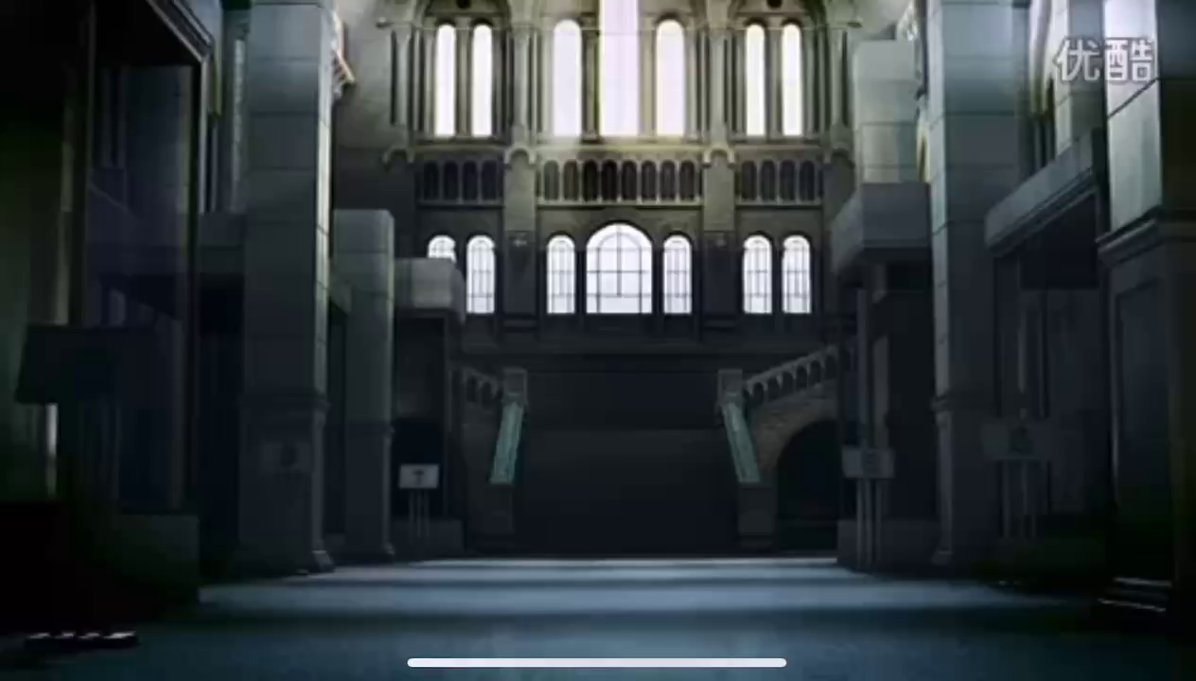
What problems are they facing?

Slide 13
Discussion
As a middle school student, what should we do to keep our traditional art forms alive?

Slide 14
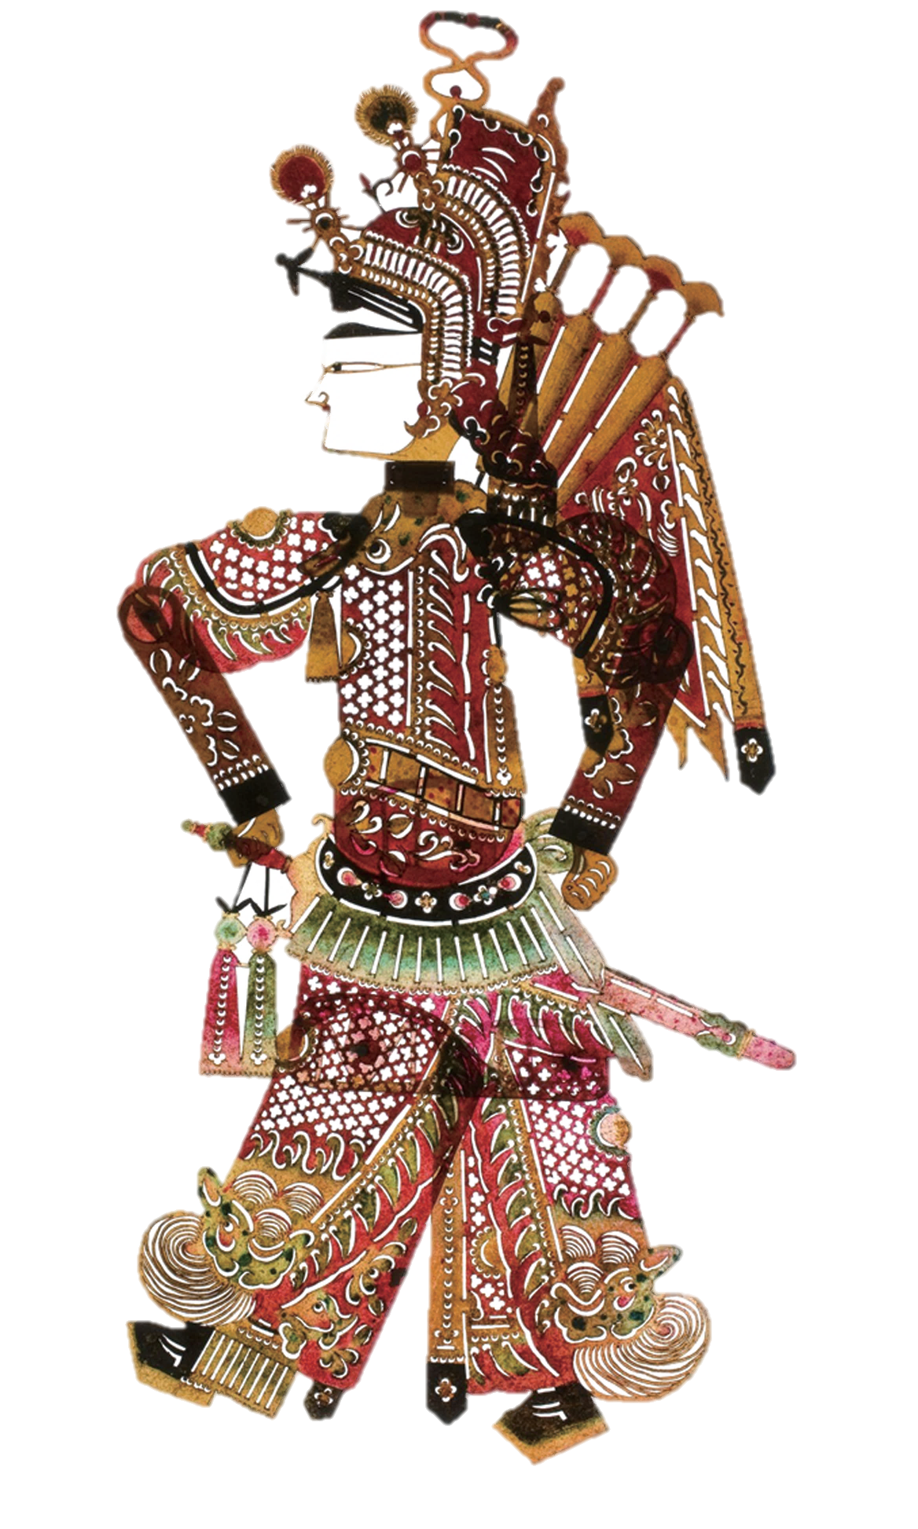
Introduce shadow puppet plays to your parents.
Write a report on how to keep traditonal art forms alive.
Homework

Slide 15
Thank you for listening!

