Slide 1



张家港市东渡实验学校
季 敏
2022.11.23

Slide 2

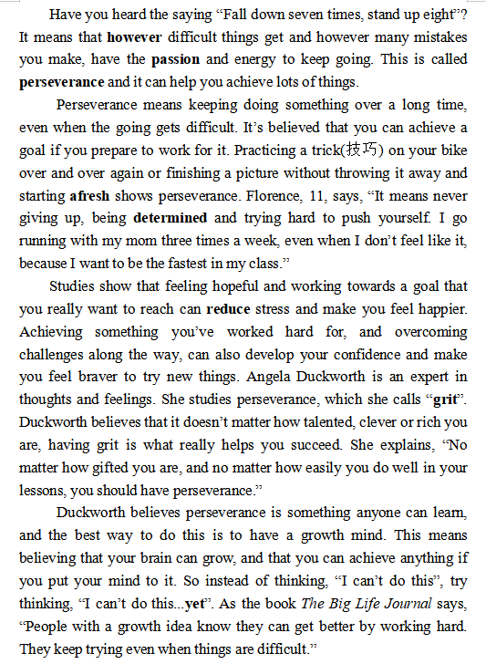
1.
1. The passage is mainly about
.
2.
perseverance
/grit
/ˌpɜ:sɪˈvɪərəns/
2. Perseverance means .
3.
3. Perseverance can .
4. The best way to have perseverance is to .
4.

Slide 3
1.
2. Perseverance means .
2.
having the passion and energy to keep going however difficult things get and however many mistakes you make
3.
keeping doing something over a long time even when the going gets difficult
never giving up, being determined and trying hard to push yourself
4.
keeping trying even when things are difficult

Slide 4
1.
2. Perseverance means .
however = no matter how
2.
whenever = no matter when
whatever = no matter what
having the passion and energy to keep going however difficult things get and however many mistakes you make
3.
having the passion and energy to keep going whenever you and whenever you
meet difficulties
make mistakes
4.
having the passion and energy to keep going whatever and whatever
difficulties you meet
mistakes you make

Slide 5
1.
3. Perseverance can .
2.
Feeling hopeful and working towards a goal that you really want to reach can reduce stress and make you feel happier.
Achieving something you’ve worked hard for and overcoming challenges along the way can also develop your confidence and make you feel braver to try new things.
Having grit is what really helps you succeed, no matter how talented, clever, or rich you are.
3.
4.

Slide 6
1.
4. The best way to have perseverance is to .
have a growth mind
2.
成长型思维
I can’t do this.
I can’t do this yet.
3.
yet: up until right now, which
means it can still happen
e.g. I am not a great reader yet,
but with a lot of practice I will be.
4.

Slide 7

1.
4. The best way to have perseverance is to .
have a growth mind
2.
e.g. I am not a great reader yet,
but with a lot of practice I will be.
3.
4.

Slide 8
1.
5. The best title for this passage is
.
2.
power
The of Perseverance
3.
the key to success
Perseverance --
perfect
Perseverance makes
4.

Slide 9
Post-reading
You are invited to give a speech about perseverance/grit.
1. What do you think is perseverance?
2. Can you give an example?
(e.g. learning a skill, a sport, a musical instrument...)
3. If yes, what have you learned from it?
If no, what can you do to have perseverance?
Dear teachers and classmates,
I am ... It’s my great honor to give a speech about perseverance/grit.
...
That’s all for my speech. Thank you!

