Slide 1

Together We Are Stronger

Slide 2

Together We Are Stronger
Teamwork

Slide 3
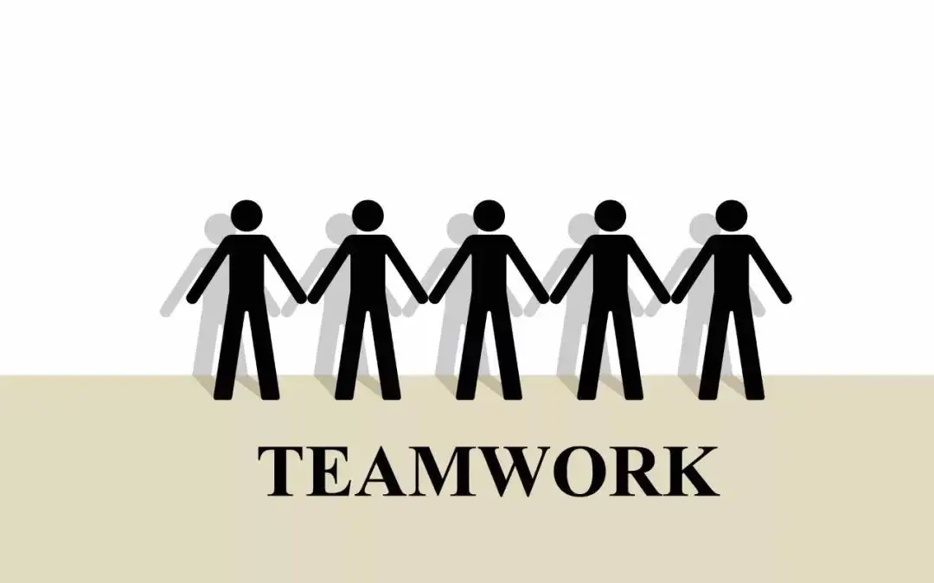
Review
Q: What’s teamwork?
Team members work together

Slide 4
Review
Q：What does each letter of “Team” mean?
T for
E for
A for
M for
Together
Everyone
Achieves
More

Slide 5
Review
Q: What roles can you find in a team?
领导者
leader
智多星
thinker
实干家
Doer
专家
Expert
监督者
Monitor

Slide 6
Reviewing
Q:What qualities should a good team player have?
optimistic
happy
generous
helpful
cooperative
competitive
……

Slide 7
Extension
Who is the best team in your heart?
Class ? School ? Company? City? Country?

Slide 8
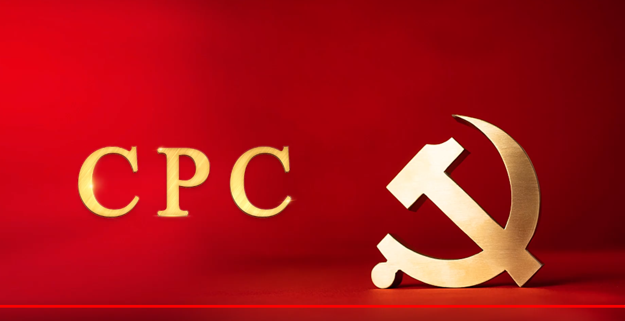
Extension
CPC International Image Publicity Film
中国共产党国际形象宣传片

Slide 9
Extension
Five roles | Representatives
leaders | the People of China
Thinkers | Chairman Mao, President Xi
Experts | Karl Marx, Friedrich Engels
Monitors | Qian Xuesen, Yuan Longping
Doers | the NPC(全国人民代表大会）

Slide 10
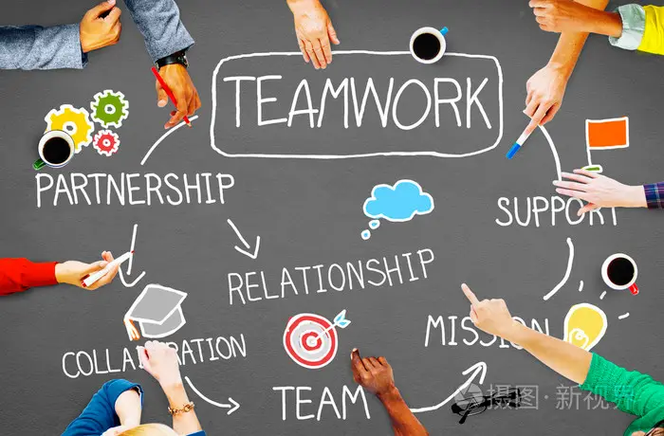
Real Life Skills

Slide 11
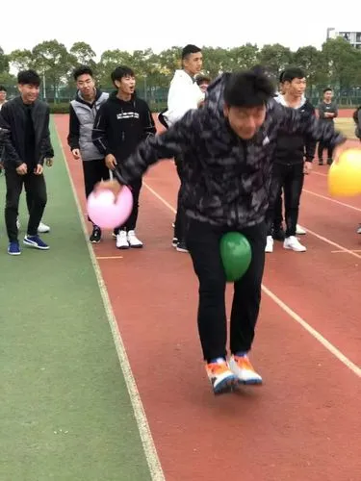
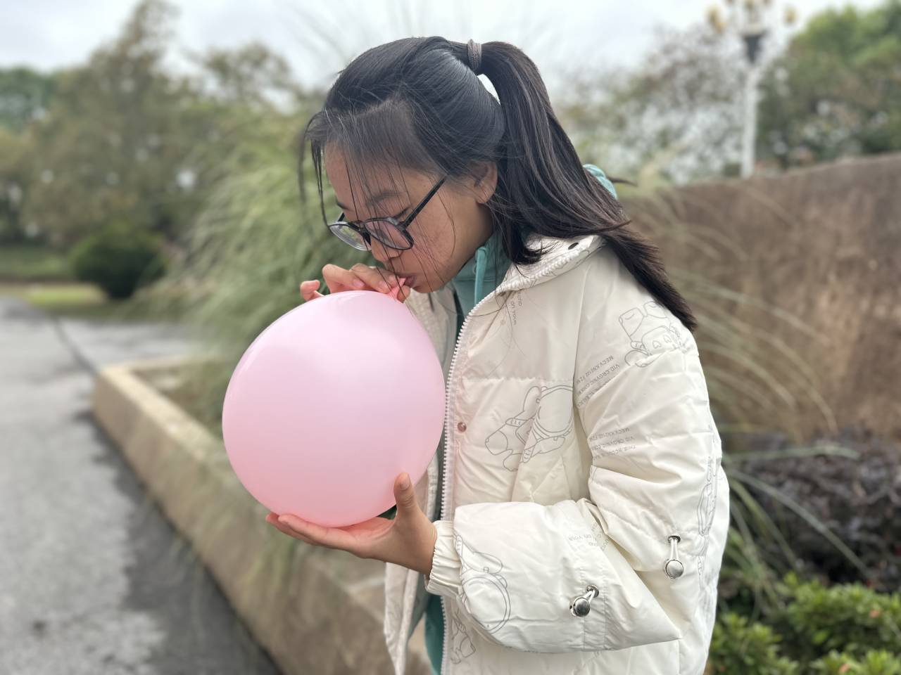
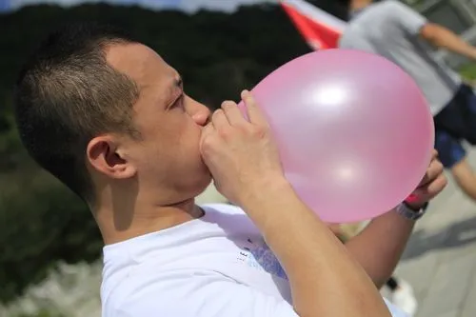
Real Life Skills----Game
Balloon blowing and delivering

Slide 12
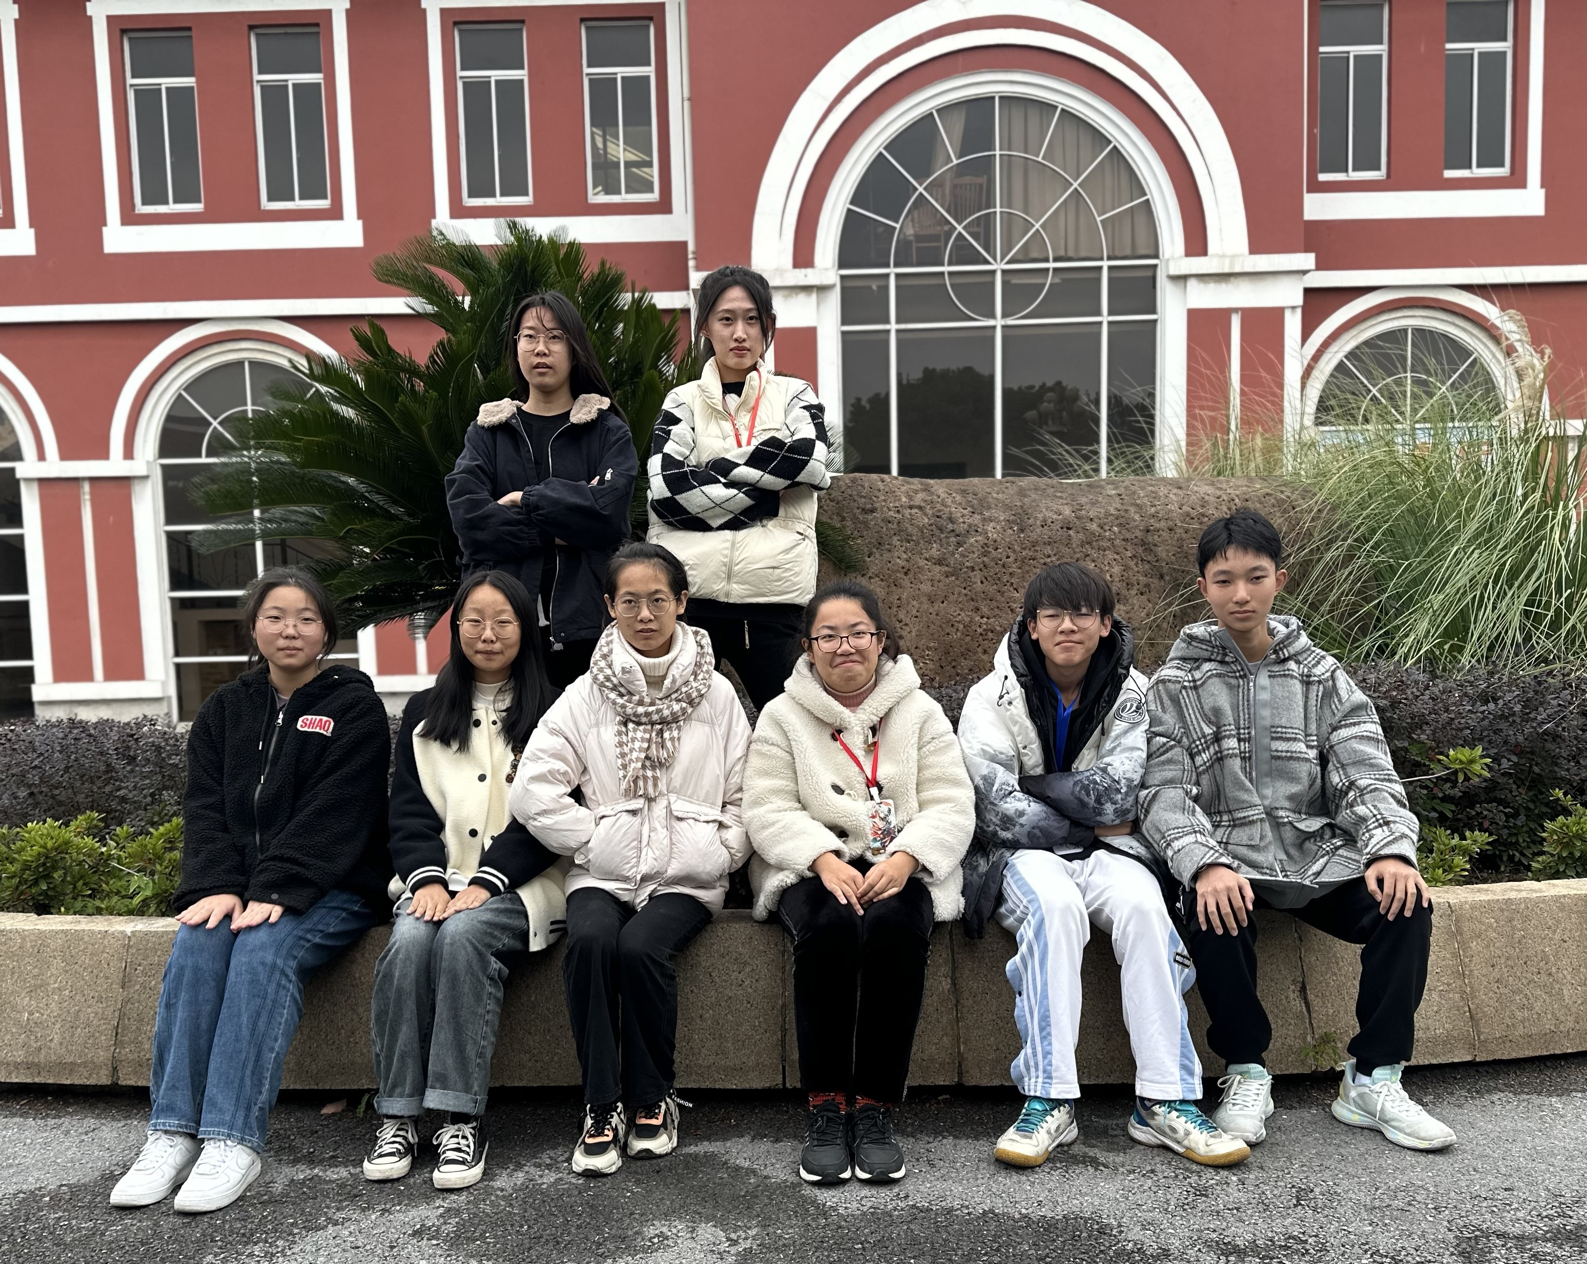
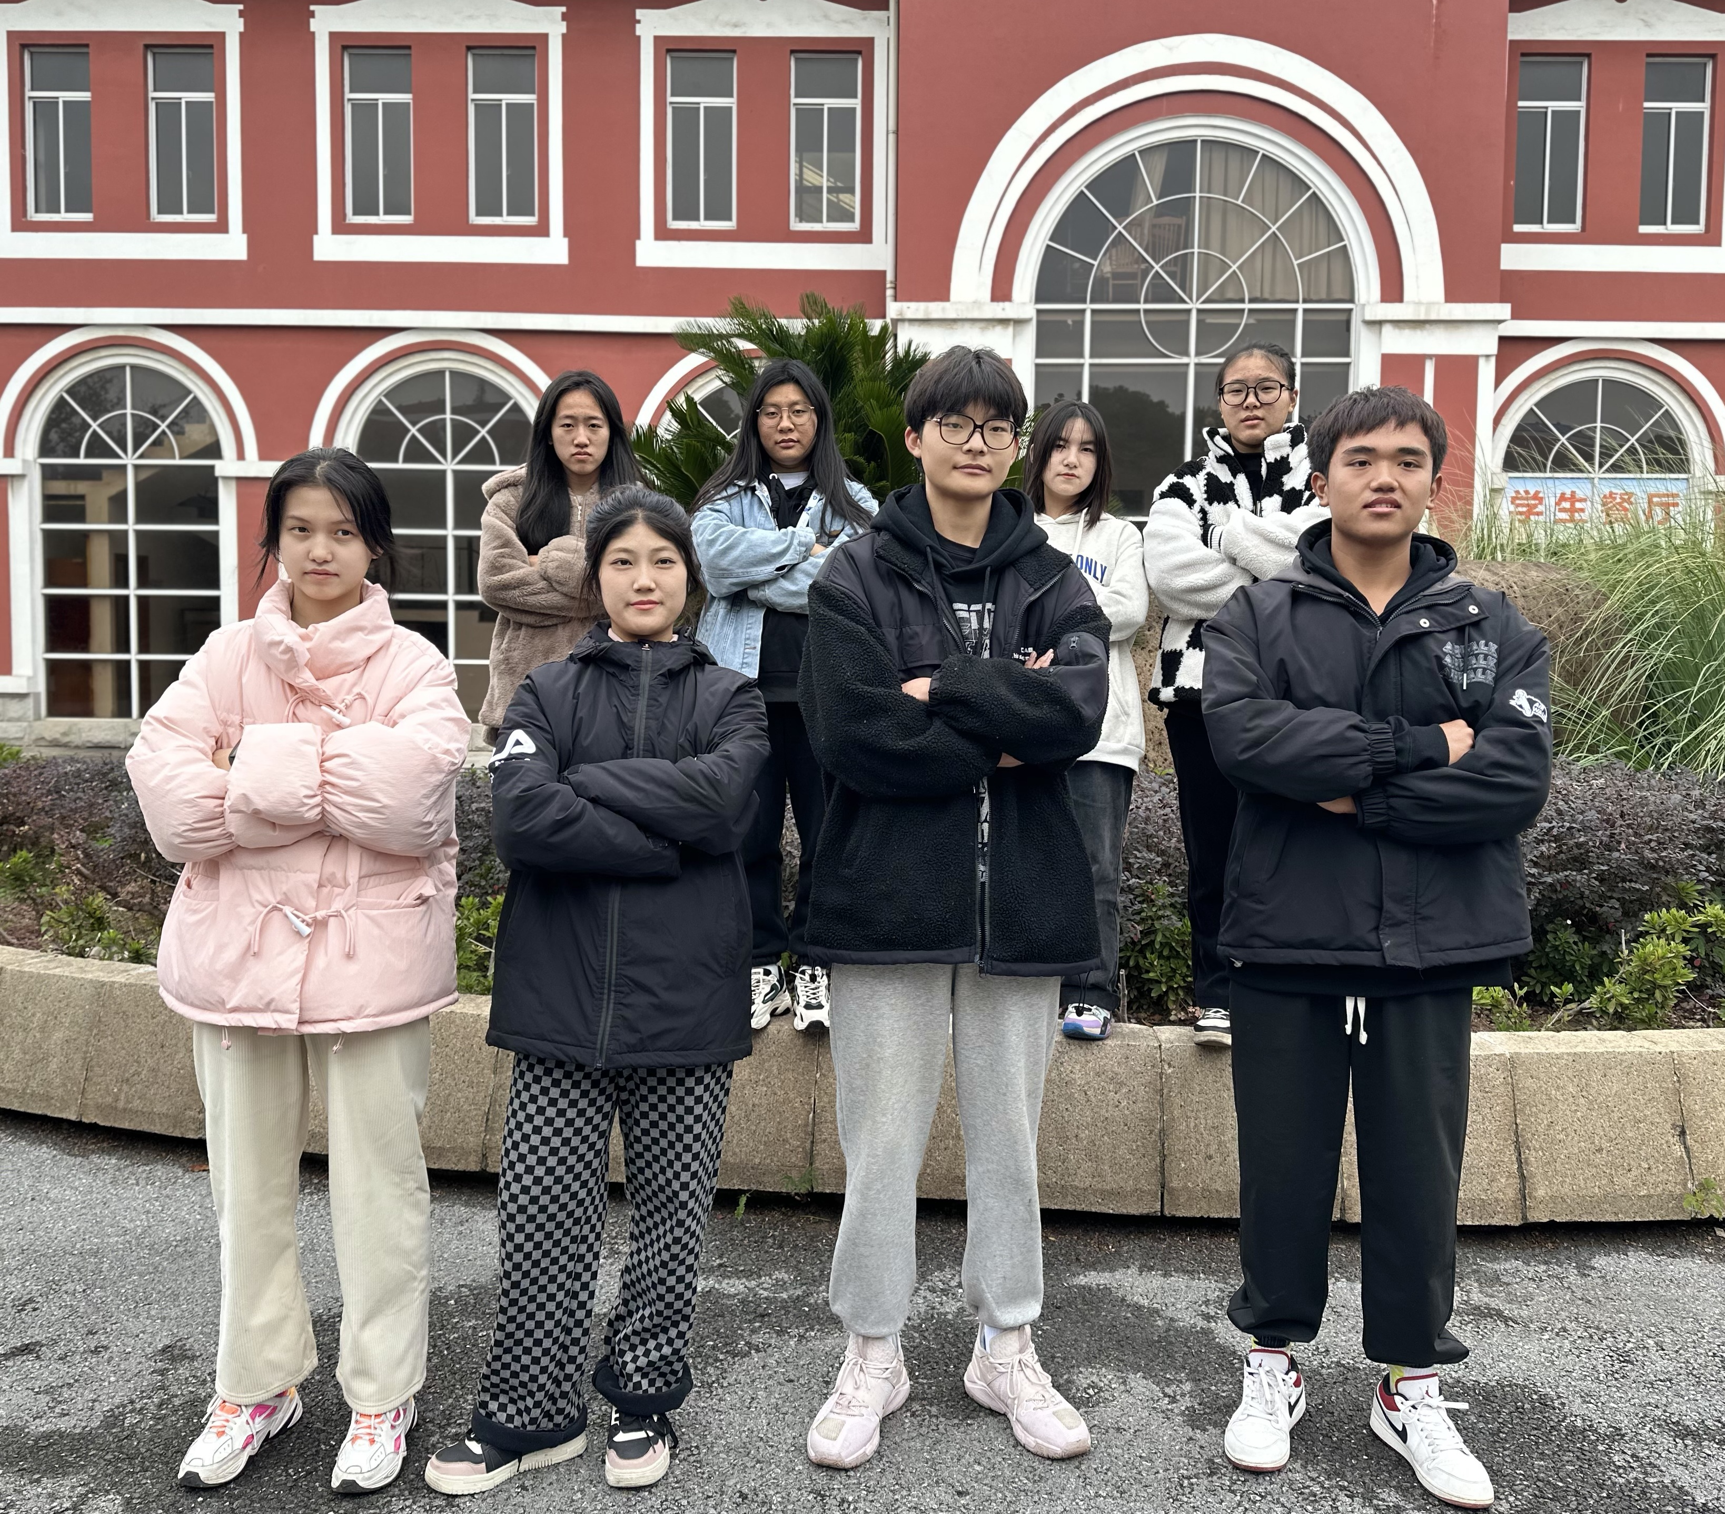
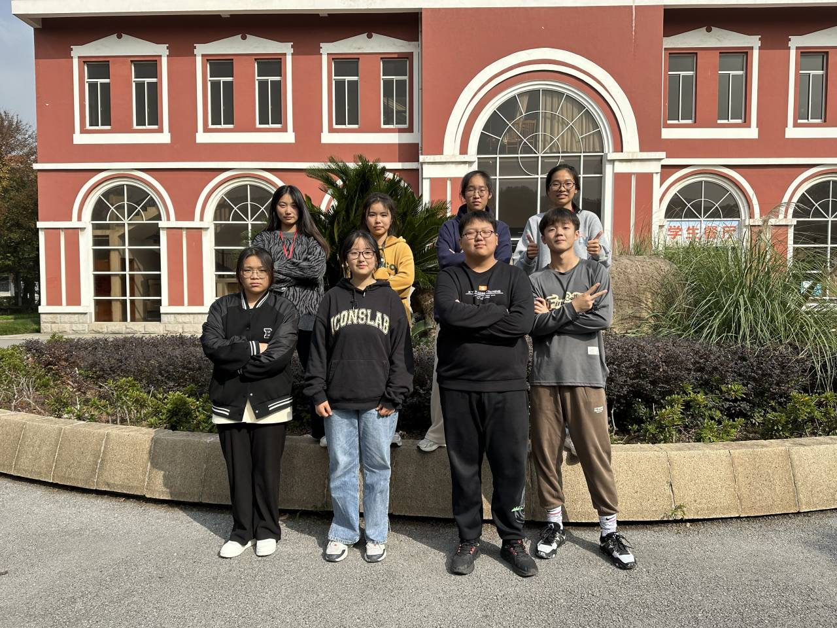
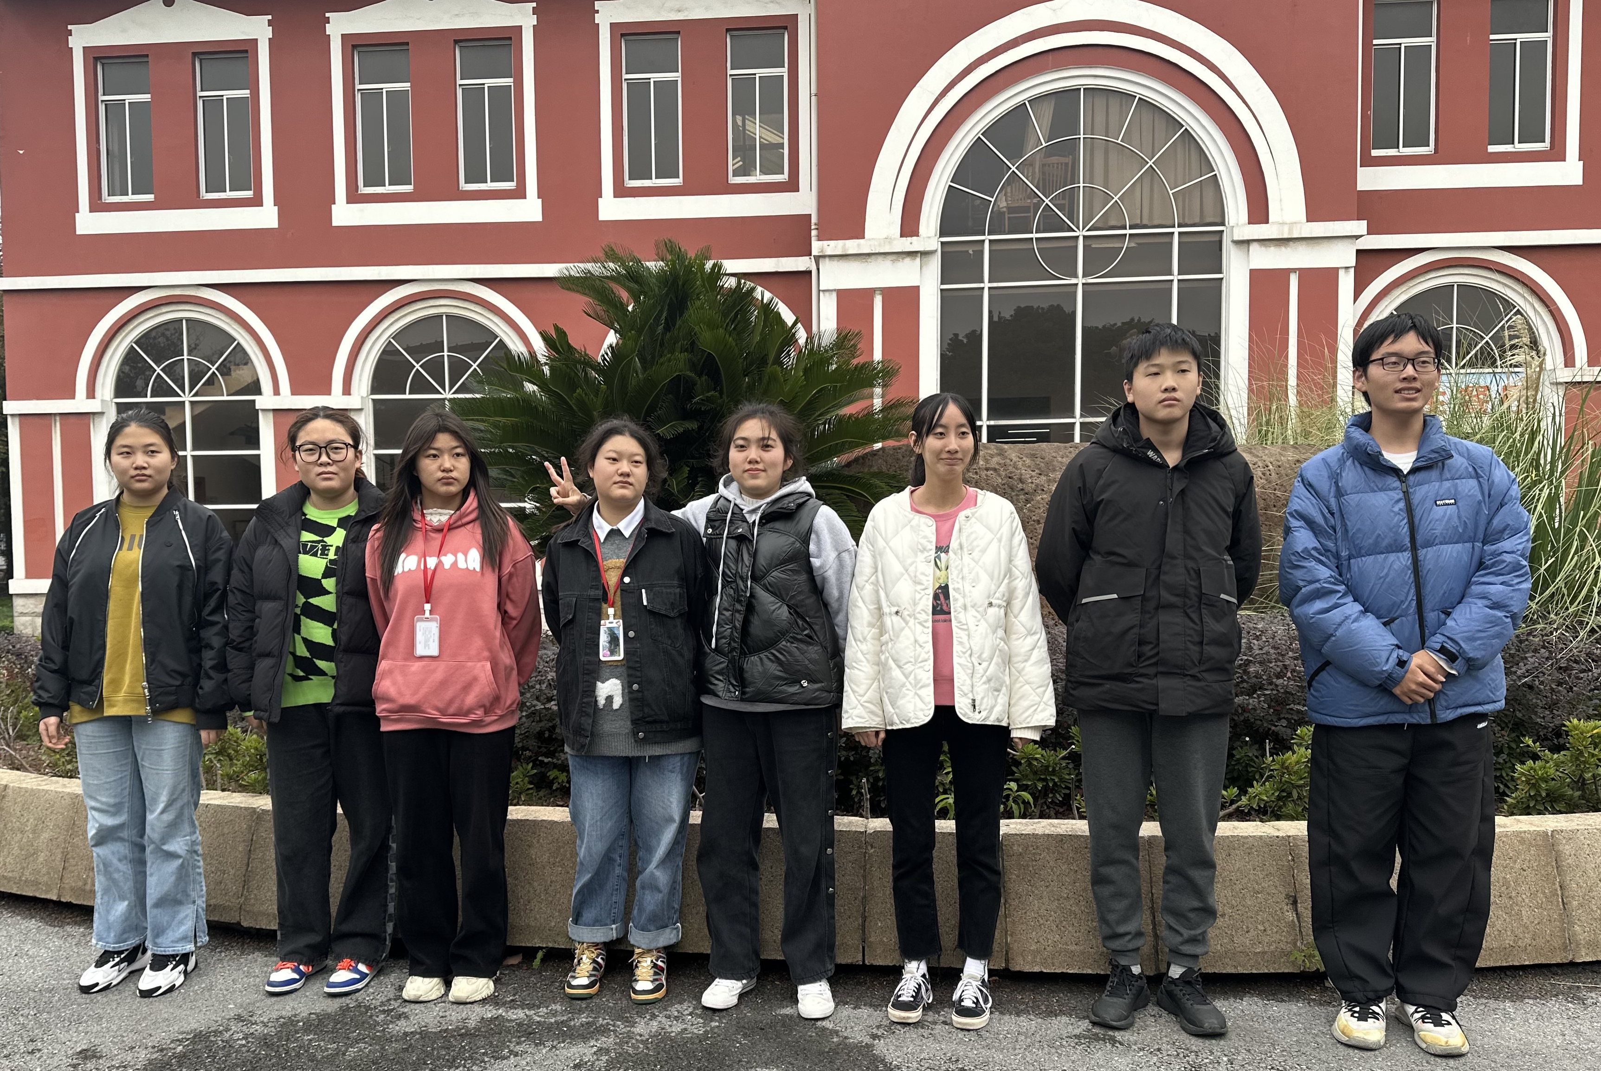

Slide 13
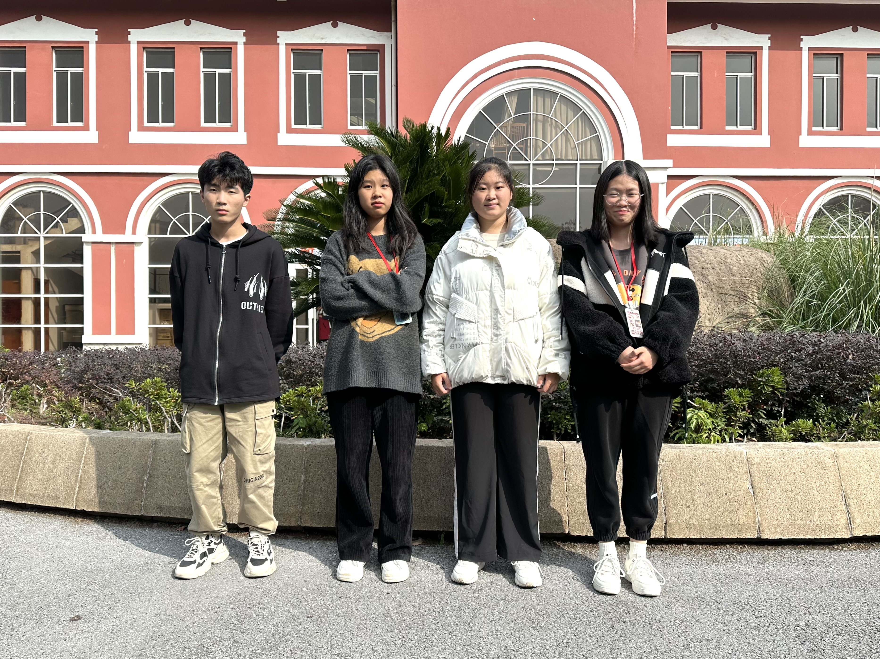
Real Life Skills----Game
Timer Group
Photographers Group

Slide 14

Real Life Skills----Game
Balloon Blowing and delivering Game

Slide 15
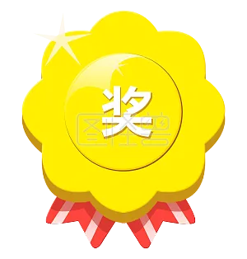
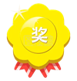
Real Life Skills----Game
Vote “Bests”
Fastest Award (blowing / Delivering)
Eye Catching Award
Best Teamwork Award

Slide 16
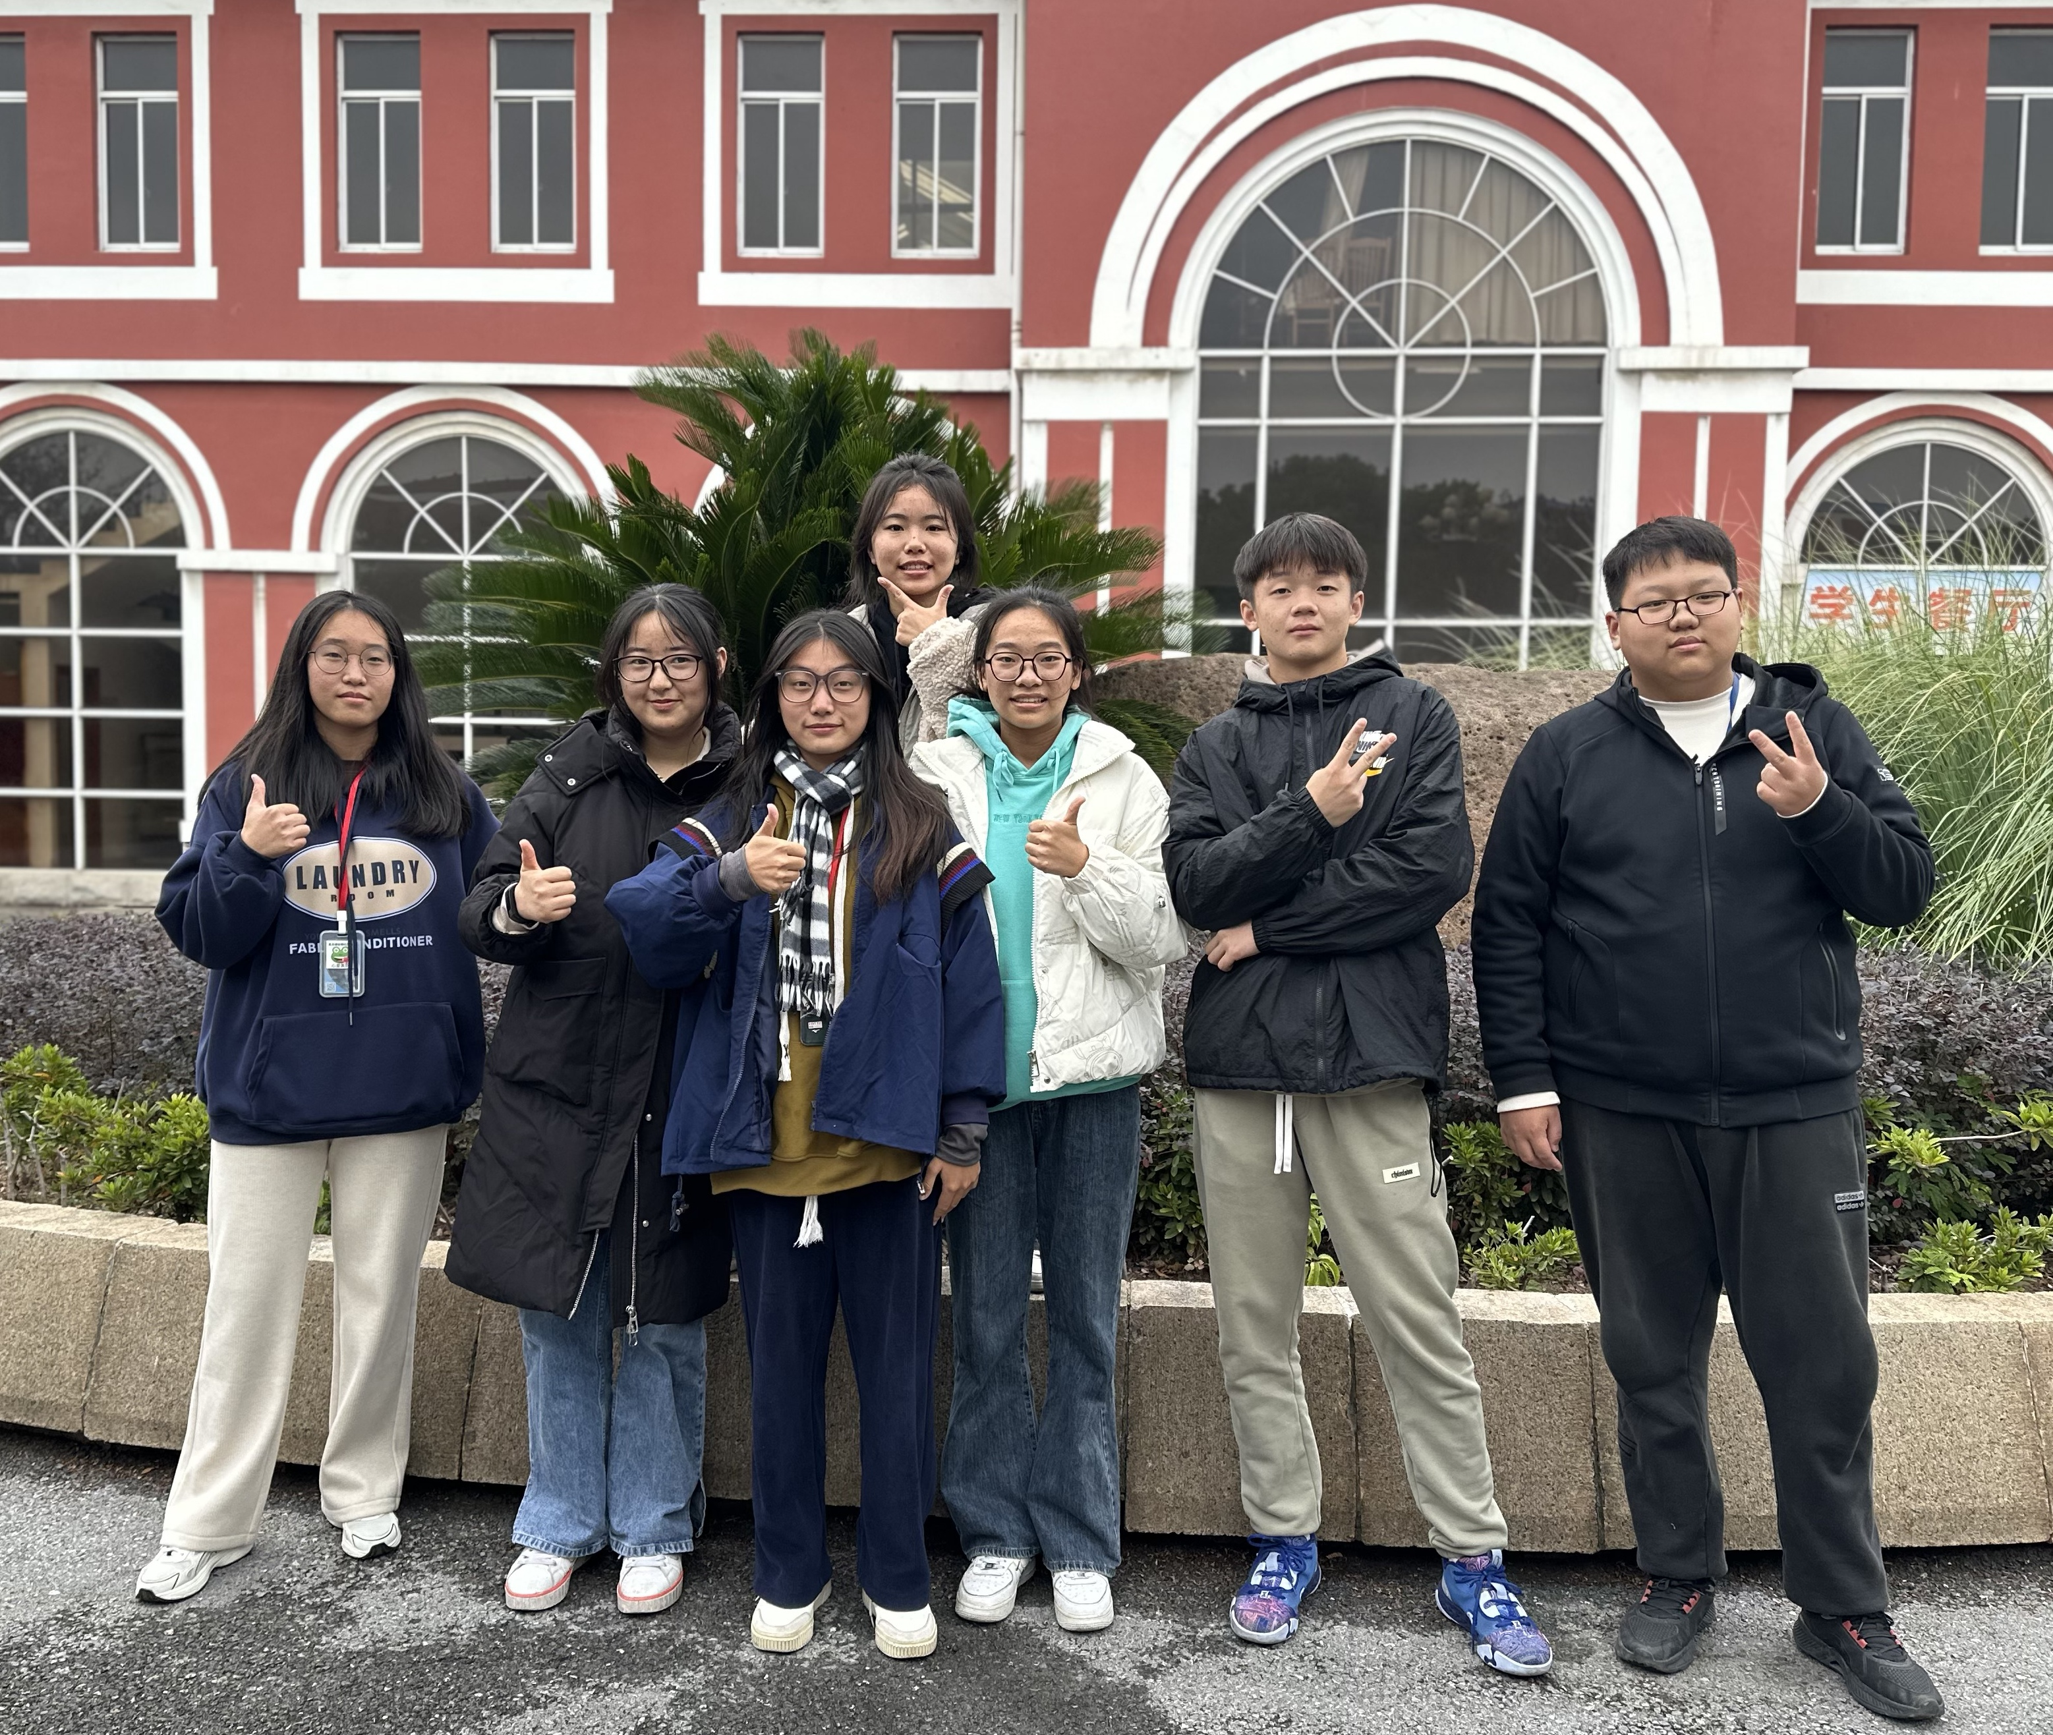
Real Life Skills----Game
Winners the No.1 team share their successful experience
We are the Champion!
第一名团队照片

Slide 17
Real Life Skills----Questionnaire
?
Are you a good team player
What’s your score?
40-50: Congratulations! You are a great team player.
30-39: You are on the right track. You have the chance to be a great team player.
20-29: You will have to struggle to become a team player.
19 and below: It’s high time to find out why you are always alone and lonely!

Slide 18
Real Life Skills ---- Self evaluation
Do you have teamwork spirits?
Team Success qualities
Do you have? | The Score(1-5)
Optimistic
happy
generous
helpful
cooperative
competitive
5 score - quite agree
4 score -most agree
3score - somewhat agree
2 score - partly disagree
1 score - most disagree

Slide 19
Keys to teamwork
Team Success Factors
Purpose目标
Process过程
Communication 交流
Involvement参与
Commitments义务
Trust 信任

Slide 20
Real Life Skills----Group Evaluation
How do you think of your team’s performance?
Team Success factors | Your team
Purpose（目标）
Process（过程）
Communication（交流）
Involvement（参与）
Commitments（义务）
Trust（信任）
5 score – very well
4 score – good
3 score – medium
2 score – not so good
1 score – bad

Slide 21
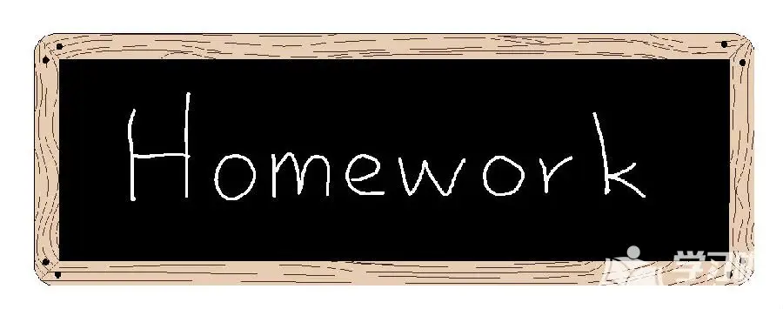
Assignment
Write a short essay about “teamwork spirit”
after you watched the video clips of CPC’s
achievements and history.

