Slide 1
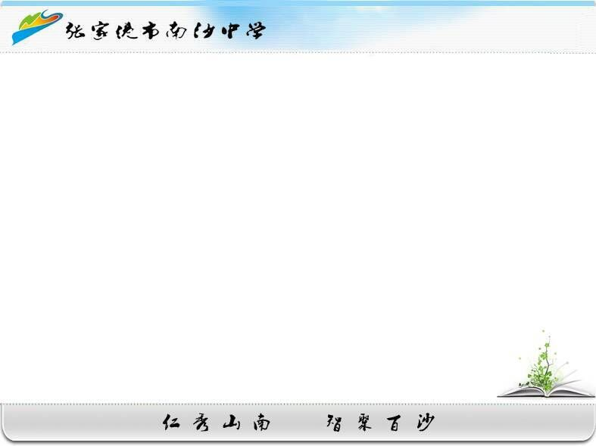
Learning aims:
9A U6 Extended Reading
After the lesson, students are able to :
1.guess the meaning from the context
2.analyze the article
3.present and support their opinions
in different ways
4.Infer who gives the opinion
张家港市南沙中学
王强

Slide 2
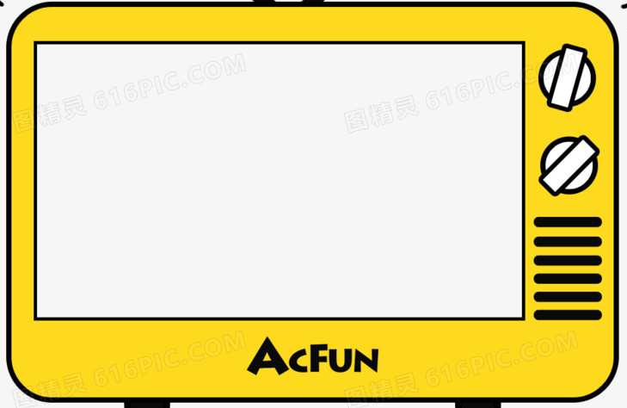

Let’s watch a video!
Notes:
Do you like watching TV? Let’s watch together! After watching it, pls tell me what type of TV program is it and what kind of food is it about?
An advertisement/ junk food 梳理单词，阅读前的准备 ，what do you think of junk food? Unhealthy , then some people think food should be banned

Slide 3
What type of TV program is it?
What kind of food is it about?
What do you think of the food?
An advertisement. ／A TV ad.
About junk food
|dʒʌŋk|
I think junk food should be banned.
ban |bæn|
should not be allowed
Notes:
通过视频引入垃圾广告主题，三个问题扫清标题词汇障碍。 T: Good morning, everyone! I am Mr Wang from Nansha Middle School! Nice to meet you! Are you ready for the class? Let’s get started! Do you like watching TV? Ok, let’s watch a video together!

Slide 4
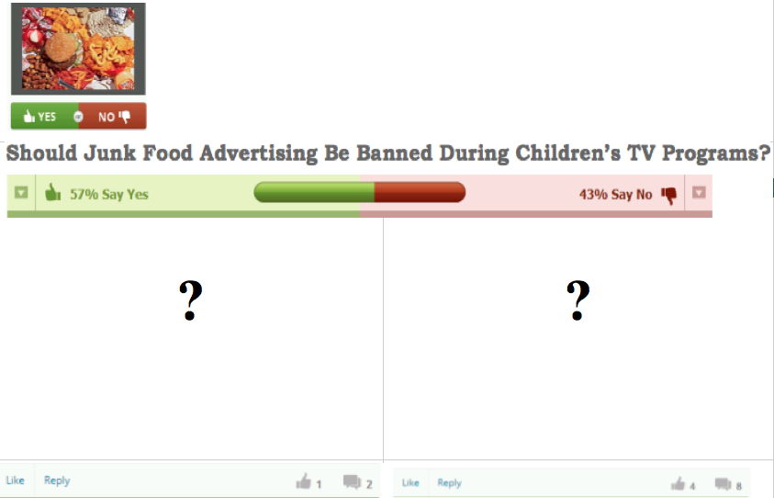
Who are they?
Agree or disagree?
What are they?
Notes:
由标题问句形式，让学生先发表看法，引导学生说出文章是在发表观点。S: Since junk food is unhealthy and you have different ideas about it? Then What is your answer to the question?

Slide 5
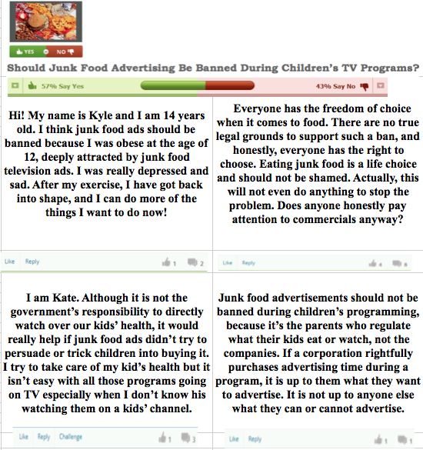
Read the article and find the answers.
Agree VS Disagree ?
agree
disagree
a student
？
agree
disagree
a mother/parent
？
Notes:
Who could guess who they are

Slide 6

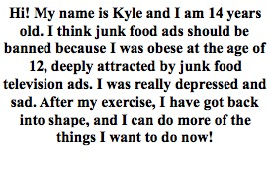
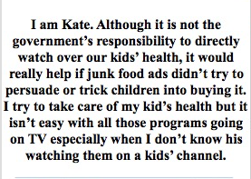
Whose responsibility is it?
What bad influences did being obese have on Kyle?
Why does Kyle/Kate think junk food ads should be banned?
What couldn’t he do because he was obese?
|əʊˈbiːs|
What method do they use to persuade you to support their opinion?
Who | Opinion | Reasons | Way to support the opinion
I think junk food ads should be banned.
Kyle
Kate
because…was obese…
Give examples
about their life
It is not the governments’ responsibility to watch over
our kids’ health.
1…persuade or
trick…into… 2…it isn’t easy
Notes:
观点呈现正文中要体现

Slide 7



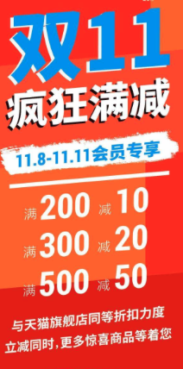
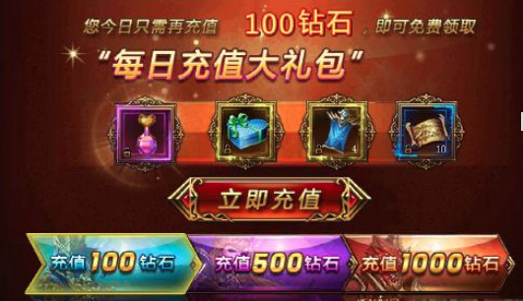
A: What do ads persuade you to do in your life?
B：They persuade…to …

Slide 8

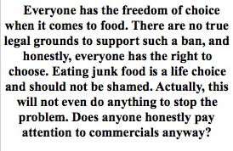
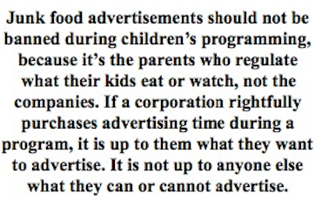
When it comes to sth 谈到某事时
What does “this” mean here？
Why is it not the company’s responsibility ?
What method do they use to persuade you to support their opinions?
Opinion | Reasons | Way to support the opinion
….when it comes to food.
this will not even do anything
to stop the problem
There are no true legal grounds
…has the right to..
a life choice
Give reasons
Junk food advertisements
should not be banned
,because it is the parents who
regulate what their kids eat,
not the companies

Slide 9


When it comes to junk food advertising, what is it up
to them?
When it comes to junk food advertising, what do you think?
When it comes to junk food advertising,
it is up to companies what to advertise.
……
When it comes to ……，……

Slide 10


Slide 11
What does “it is up to them” mean?
How do they support their opinion?
Opinion | Reasons | Way to support the opinion | What is he/she
When it comes to food, everyone has the freedom of choice.
When it comes to junk food, everyone has the right to choose what to buy/eat.
When it comes to junk food, it is up to…, not up to…..
When it comes to what to advertise, it is up to.., not up to…
When it comes to the responsibility, it is up to….
When it comes to … everyone has the freedom of choice
a lawyer /
a law maker/…
There are no true legal grounds to support …
By talking
about the right
Junk food advertisements
should not…
If a corporation rightfully
purchases advertising..
a company owner
an advertiser/…

Slide 12
Why does Kyle/Kate think junk food ads should be banned?
What does “obese” mean?
Imagine: How obese was he?
Whose responsibility is it?
A: What do ads persuade you to do in your life?
B：They persuade…to …
|əʊˈbiːs|
What method do they use to persuade people?
Who | Opinion | Reasons | Way to support the opinion | What is he/she
Kyle
I think…should…
obese／
depressed
A student /
a teenager
By talking about
their life experience
Kate
Although…, it would
really help if…
It isn’t easy
with…
a mother /
a parent

Slide 13
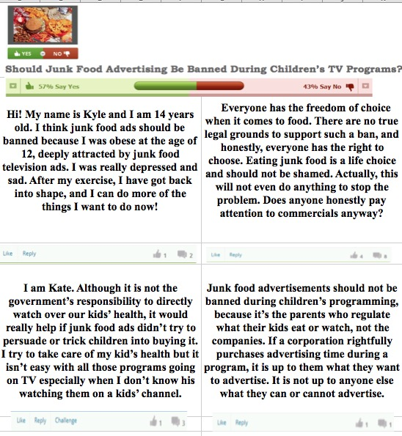
What are their reasons?
How do you know?
|əʊˈbiːs|
Whose responsibility is it?

Slide 14
What ads persuade or trick you into doing anything?
Whose responsibility is it?

Slide 17
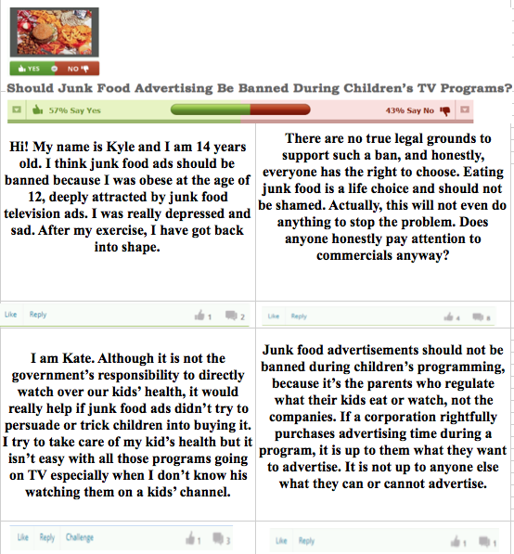
Giving an example(举例子)
Giving reasons(说理)
Giving reasons(说理)
Giving reasons(说理)

