Slide 1

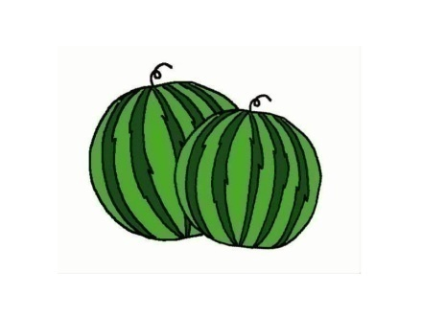

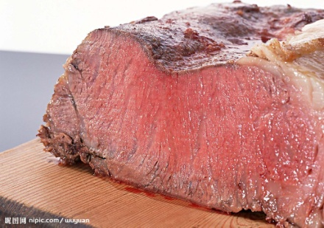

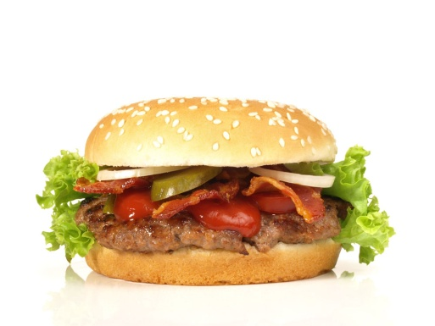
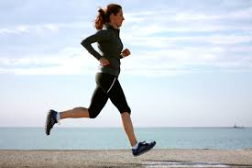
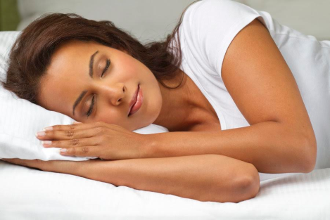
单元主题拓展阅读
By Miss Chen from No.2 Middle School

Slide 2
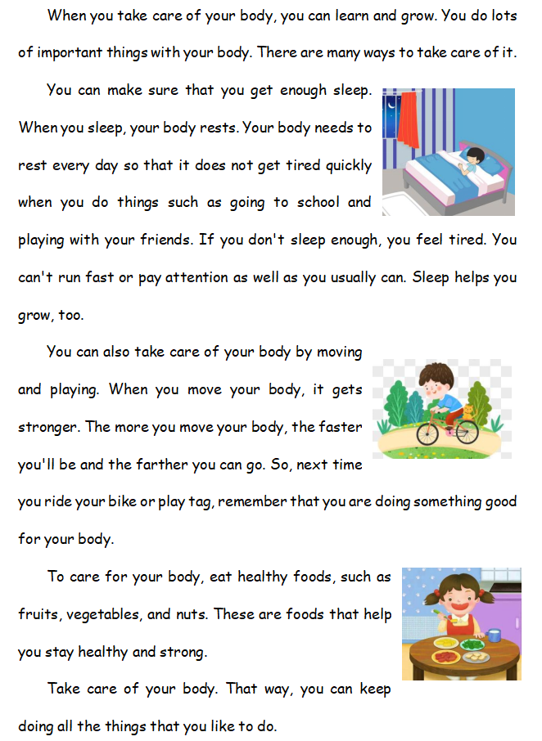
Read through the passage and answer the questions.
Para 1
1.What is the passage about?
Ways to take care of your body.
Para 1
Para 2
(
2.How many ways? What are they?
way + reasons
Getting enough sleep
Para 2
Three.
Moving and playing
Para 3
)
Eating healthy food
Para 4
Para 3
(
3.How does the writer write Para 2-4?
way + reasons
Topic sentence + supporting details.
)
4.What is Para 5 about?
Para 4
Conclusion(总结)and the advantages(好处).
(
5.Which para also talks about the
advantages?
)
way + reasons
Para 5
﹏﹏﹏﹏﹏﹏﹏﹏
﹏﹏﹏﹏﹏﹏﹏﹏﹏﹏﹏

Slide 3
Para 2: Getting enough sleep
Read Para 2 carefully and answer the questions.
You can make sure that you get enough sleep. When you sleep, your body rests. Your body needs to rest every day so that it does not get tired quickly when you do things such as going to school and playing with your friends. If you don't sleep enough, you feel tired. You can't run fast or pay attention as well as you usually can. Sleep helps you grow, too.
?
(
例如，比如
)
以便，结果是 (表结果) + 从句
Why is enough sleep so important?
Can you list(举例) some subjects you like at your school?
If you don’t sleep enough, what will happen?
Your body needs to rest every day.
So your body does not get tired quickly when you do things such as going to school and playing with your friends.
Think: What should/shouldn’t you do before going to bed so that you can have a good sleep?
+ nouns
If you don't sleep enough, you feel tired. You can't run fast or pay attention well.
I like subjects such as____________________________.
/əˈtenʃn/
____________________________so that i can have a good sleep.
Can you list(举例) the sports you like doing at your school?
as ... as
“和...一样”
as well as
“和...一样好”
+ Verb+ing
I like doing sports such as____________________________.
If you don’t sleep enough, you can't run fast or pay attention as well as you usually can.
如果你睡不够，你就不能像你通常那样跑得快或者那样专注。

Slide 4
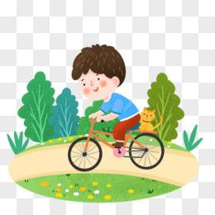
Para 3: Moving and playing
by doing sth
通过做某事
You can also take care of your body by moving and playing. When you move your body, it gets stronger. The more you move your body, the faster you'll be and the farther you can go. So, next time you ride your bike or play tag, remember that you are doing something good for your body.
1. How do you move your body?
I move my body by____________________________.
2. Why should we move our body and play?
Because when you move, the body gets stronger, you will be faster and you can go farther.
The more you move your body, the faster you'll be and the farther you can go.
The + 比较级 +......，the + 比较级 +......and the + 比较级 +......
“越....., 就越......并且越......”
3.What other advantages(好处) will you get if you move your body more?
The more you move, ________________________ and ___________________________.

Slide 5

Para 4: Eating healthy food
?
To care for your body, eat healthy foods, such as fruits, vegetables, and nuts. These are foods that help you stay healthy and strong.
(表目的) 为了
1. What food is healthy?
The food such as fruits, vegetables, and nuts.
/nʌt/
n.坚果
2. Why does the writer recommend(推荐，建议) these foods?
Because these are foods that help you stay healthy and strong.
(
)
......的食物
这些是帮助你保持健康和强壮的食物。
Attributive clause（定语从句）：noun(s) + that/which/who... “......的某物”
Para 5：That way, you can keep doing all the things that you like to do.
(
)
你可以一直做所有你喜欢做的事情。

Slide 6
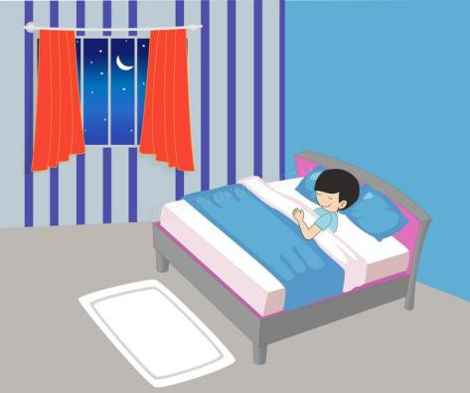
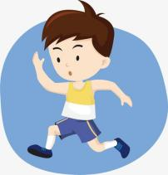
Para 5
Take care of your body. That way, you can keep doing all the things that you like to do.
(表承接) 这样的话，+完整句子
1. Get enough sleep. That way, I can____________________________.
2. Move and play. That way, I can____________________________.
3. Eat healthy food. That way, I can____________________________.

Slide 7
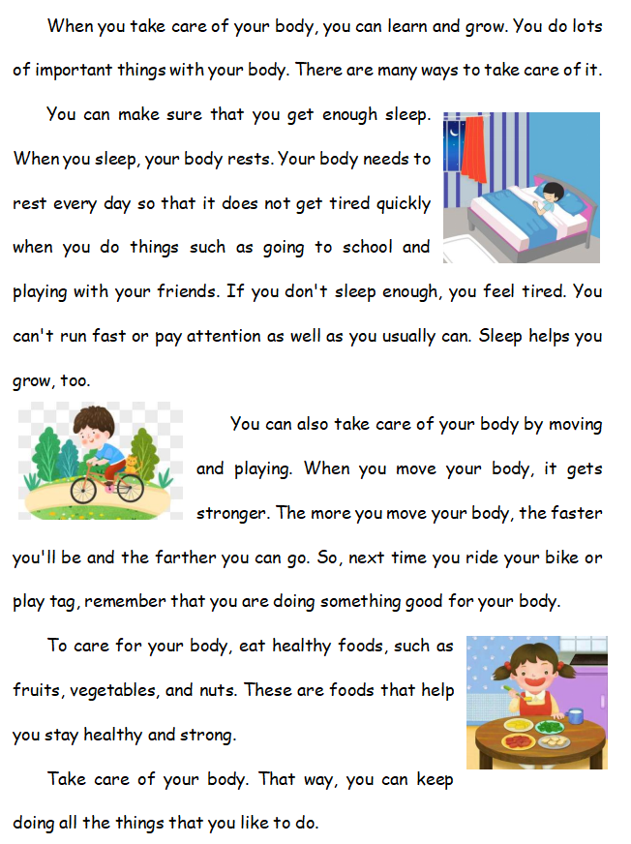
Try to find a title(标题) for this passage.
?
————————————————
How to take care of your body?
by doing sth
通过做某事
getting enough sleep
By
moving and playing
eating healthy food
I can take care of my body
by getting enough sleep, moving, playing and eating healthy food.

Slide 8
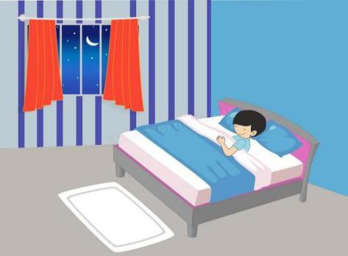
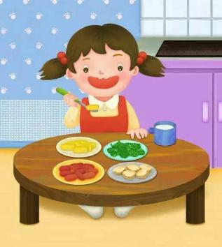
Discussion: According to what we have learnt today, if you don’t take care of your body well, what do you plan to do?

Slide 9
The first wealth(财富) is health.
Take care of your body.
Homework
1. Review the expressions and sentence patterns in this passage;
2.Try to change your lifestyle and take care of your body healthily.

