Slide 1
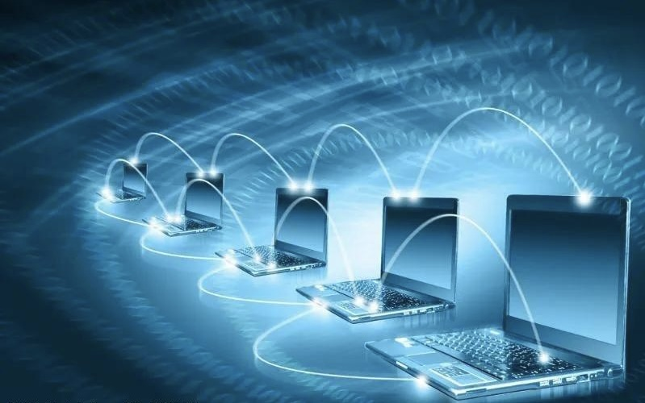
Unit 7 The Internet
By Qian Haihua
(No.3 Vocational School)
Reading part

Slide 2
Have a guess ：
It's a “toy” but it always be expensive.
It is small but with high-tech(高科技).
We love it and also hate it.
A mobile phone
we love it because it brings us convenience and happiness.
We hate it because it wastes us a lot of time .
Who can guess what it is ？

Slide 3
Watch a video：
Try to get the advantages of the phones in the video:
order the car
go shopping
pay for the subway
mobile Internet
plan a trip
book the ticket
see the doctor

Slide 4
Free talk：
What do you usually do by using your phone?

Slide 5
Fast reading：
1. Choose the title of the passage
A. A Day with the Phone
B. A Day with Mobile Internet
C. A Day During the Holiday

Slide 6
2. Choose the structure of passage.
①---②③--④⑤
①---②③④⑤
①②---③④⑤
①②---③--④---⑤

Slide 7
Careful-reading ：
Finish the T or F questions:
1) You can use a mobile phone as a clock alarm.
2) You can use a mobile phone when studying online.
3) You cannot depend on your mobile phone to discuss things with teachers and other students.
4) You can use your mobile phone to order food and set your desired time.
5) You can use your mobile phone to search for a shared bicycle nearby.
T
P2 L2
T
P2
can
F
P2 L4
T
P3
T
P5 L2

Slide 8
Careful-reading ：
Part one:
1
Introduction
A day with mobile Internet
Part two:
2--5
Body

Slide 9
Careful-reading ：
Introduction part
Para one
Translation:
With smart phones, the Internet becomes mobile, and we can do most of the things we do on a typical day without moving around much.
___________________________________________________
有了智能手机，互联网变得可以移动，我们不用四处奔走就可以完成一天中的大部分事情。

Slide 10
Careful-reading ：
Body part
Para 2—5：Try to get the detailed information of each part.

Slide 11
Para two
When | Activities | Usages of your phones
At 7:50 | have an online class | 1. _______for morning hobby classes; 2. ________ carefully; 3. ________ the questions; 4. ________ with the classmates
ring
listen
answer
discuss

Slide 12
Para three
When | Activities | Usages of your phones
During the break | ______ your food | log onto a take out app
order

Slide 13
Para four
When | Activities | Usages of your phones
In the afternoon | go over and do homework and listen to music | ______ your homework; 2. __________a music app icon
send
click on

Slide 14
Para five
When | Activities | Usages of your phones
_______________ | go to a nearby park | __________the nearest shared bicycle
search for
After an hour or so

Slide 15
Retell this part ：
Today, I’m very happy to share my day with mobile Internet with you.
 | Activities | Usages of your phones
At 7:50 | have an online class | 1. ring for morning hobby classes; 2. listen carefully; 3. answer the questions; 4. discuss with the classmates
During the break | order your food | log onto a take out app
In the afternoon | go over and do homework and listen to music | 1. Send your homework; 2. Click on a music app icon
After an hour or so | go to a nearby park | search for the nearest shared bicycle

Slide 16
Careful-reading ：
Finish the multiple choices:
The passage is organized by _________?
place B. event C. persons D. time

Slide 17
time
 | Activities | Usages of your phones
At 7:50 | have an online class | 1. ring for morning hobby classes; 2. listen carefully; 3. answer the questions; 4. discuss with the classmates
During the break | order your food | log onto a take out app
In the afternoon | go over and do homework and listen to music | 1. Send your homework; 2. Click on a music app icon
After an hour or so | go to a nearby park | search for the nearest shared bicycle

Slide 18
Careful-reading ：
Finish the multiple choices:
The passage is organized by _________?
place B. event C. persons D. time
D

Slide 19
Careful-reading ：
Finish the multiple choices:
2. what’s the writer’s attitude to the mobile internet?
A. positive B. negative C. neutral D. indifferent
A
How about you?

Slide 20
Post-reading ：
Discussion
What’s your opinions on using the mobile Internet?
VS
Should do
Shouldn’t Do

Slide 21
Post-reading ：
Watch a video
A speech: The influence of the Internet, given by our friend Chu Sida

Slide 22
Mobile Internet: good or bad?
• listen to music
• make us relaxed
• chat with friends
• watch short videos
• have online classes
…
• is bad for our eyesight
• affect our study
• is easy to be addicted to playing games
• too much radiation
• cut into family time
…

Slide 23
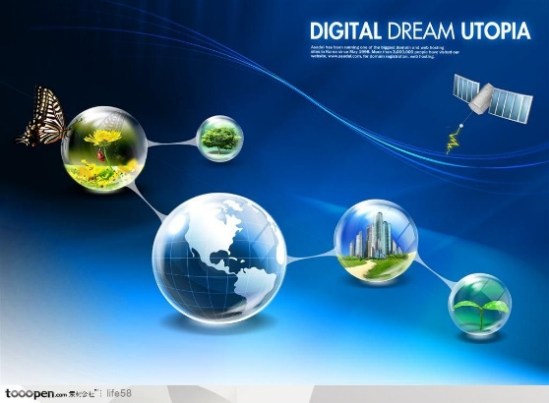
Conclusion ：
brings convenience to our daily life
a double-edged sword(双刃剑), we should treat it wisely
Internet
improves the development of our science
promotes the progress of our society

Slide 24
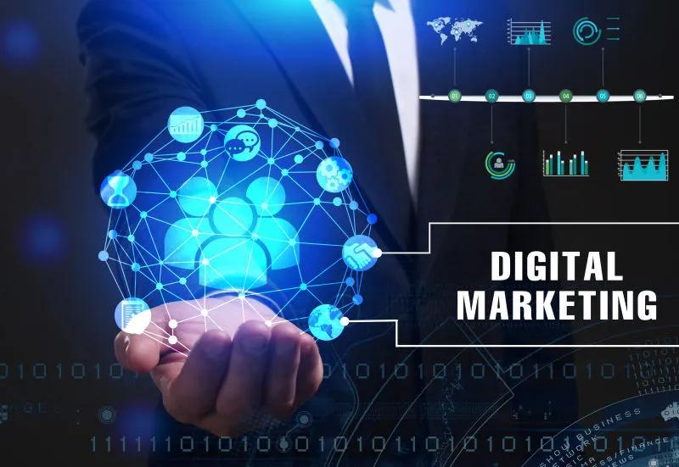
Conclusion ：
As a member of the society, especially we are students, we are the future of our motherland, so when we use the internet, we should have right world view, right life view and right value view, and try to be a wise and excellent successor（接班人）.

Slide 25
Homework
1. Finish the related exercises on workbooks.
2. Preview the following two parts, try to raise some questions.
You must
You may

Slide 26

Thank you !

