Slide 1






Grammar
Modal verbs（2）
张家港中等专业学校 陈娟 2023.11

Slide 2

Learning Goals:
1. Consolidate the using of Modal verbs.
2. Understand some special usage of Modal verbs.
3. Master the specail usage of Modal verbs.

Slide 3



Special Usage 1
Possibility
can’t be (表否定的猜测) must be (表肯定的猜测)
can’t
1. Michael _____ be a policeman, for he’s much too short.
2. This book ________ be Lily’s, here’s her name.
must
mustn’t means you can never do it!

Slide 4

Special Usage 1
Possibility
Lily travelled around the world last year.
she _______________ by bus, she ________________ by plane.
can’t have travelled
must have travelled

Slide 5
Special Usage 1
Possibility
can’t have done (对过去否定的猜测)
must have done (对过去肯定的猜测)
can’t have been
1. The room is in a terrible mess. It ______________ cleaned.
2. The wine bottle is nearly empty. You _____________ (drink) a lot.
must have drunk

Slide 6

Special Usage 1
Possibility
fail in the exam
pass the exam
can’t have passed the exam
The boy was sad. He ______________________, he ________________________.
must have failed in the exam

Slide 7
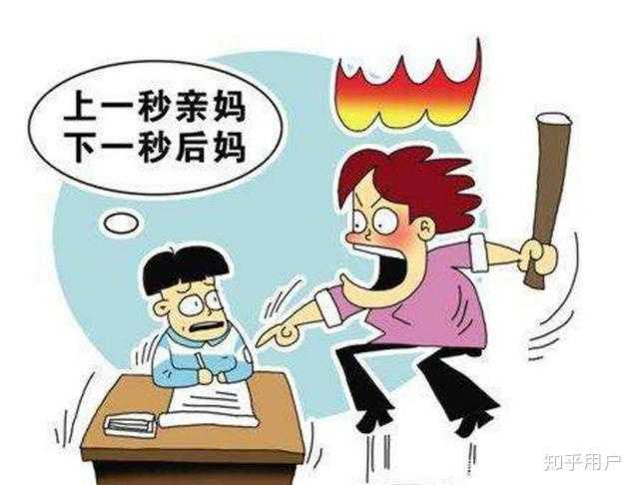
Special Usage 2 Subjunctive Mood
He ought to have worked hard!
should/ought to have done 过去本应该做某事却未做
could have done 过去本能够做某事却未做

Slide 8
Special Usage 2 Subjunctive Mood
1. You ________ those letters. Why didn’t you?
A. should post B. should have posted
C. must have posted D. ought to post
2. ——Oh,my God! I just missed the last bus back home
——That’s really bad. I’m sure you _____ it,but you didn’t hurry up.
A. had caught B. could have caught
D. could catch D. can catch

Slide 9
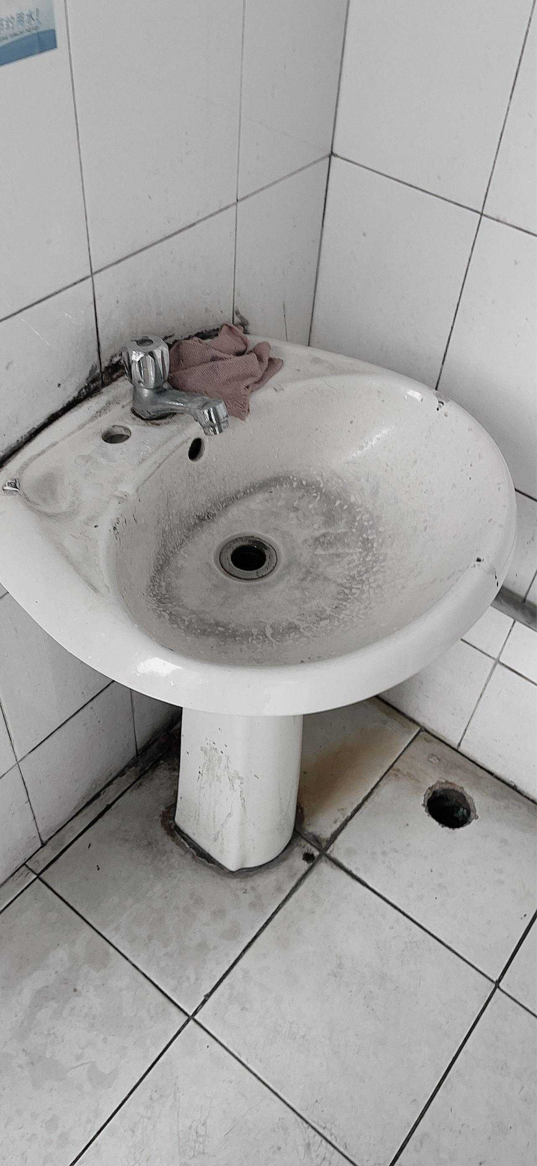
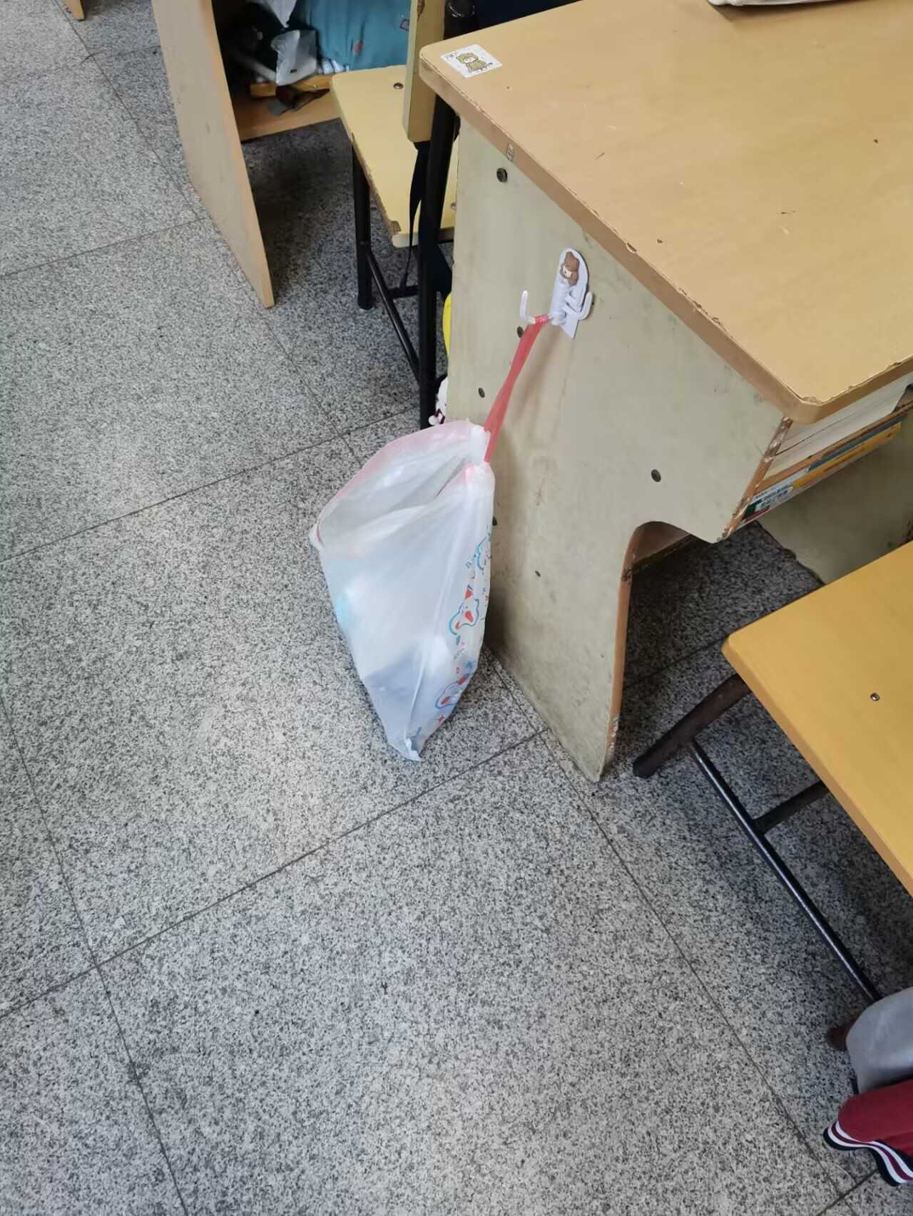
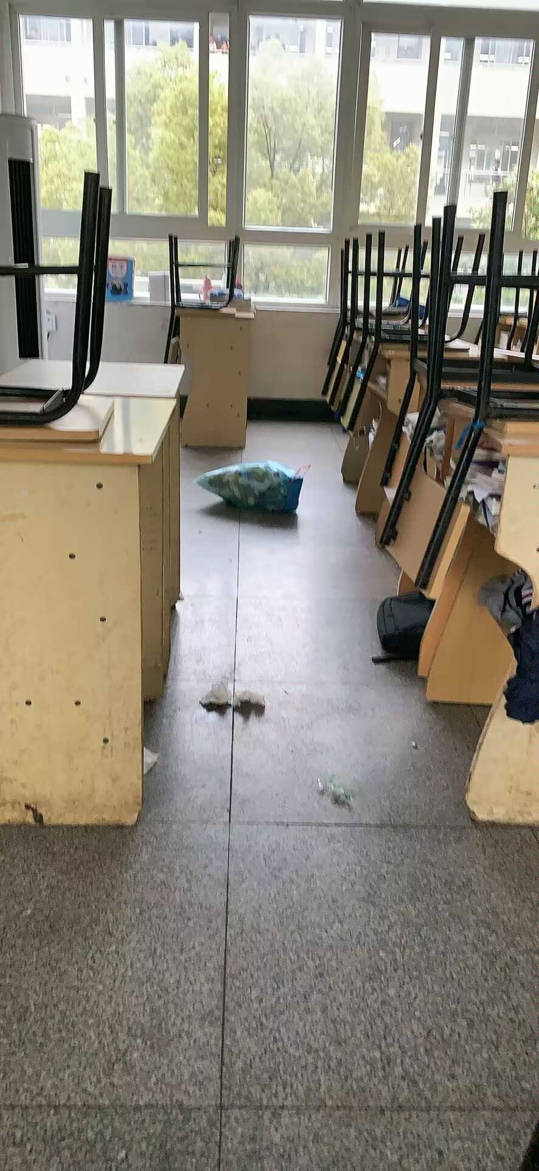
Make sentences:
should/ought to have done could have done
Special Usage 2

Slide 10
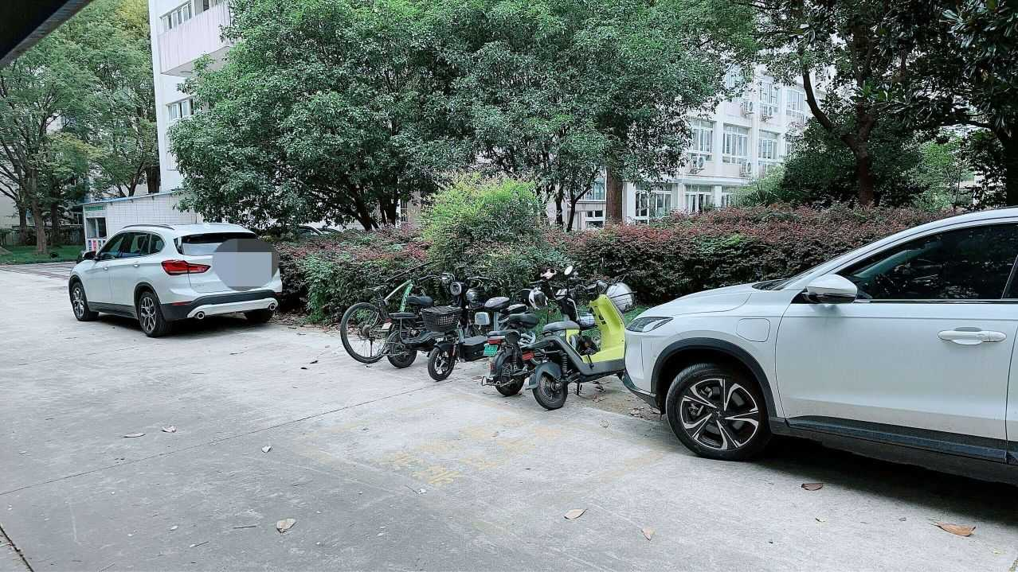
Make sentences:
should/ought to have done could have done
Special Usage 2

Slide 11
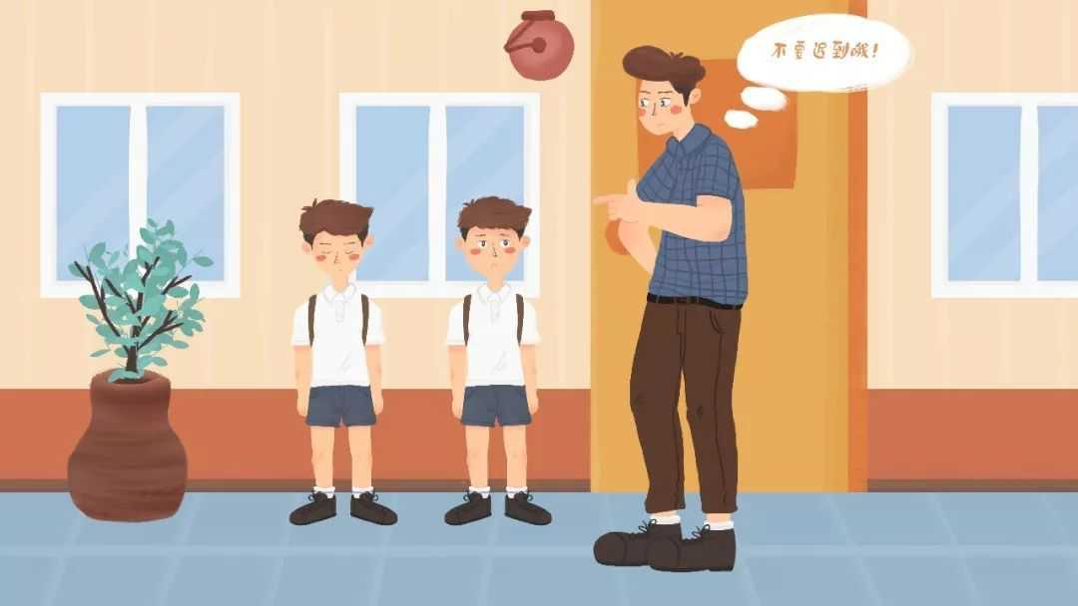
Make sentences:
should/ought to have done could have done
Special Usage 2
If they had got up early, they could have been on time.

Slide 12
Special Usage 3
If + Subjunctive Mood
时态类型 | If 引导的条件句谓语形式 | 主句谓语形式
与现在事实相反 | did/were | should/would/might/ could do
与过去事实相反 | had done | should/would/might/ could have done
与将来事实相反 | did should do were to do | should/would/might/ could do

Slide 13
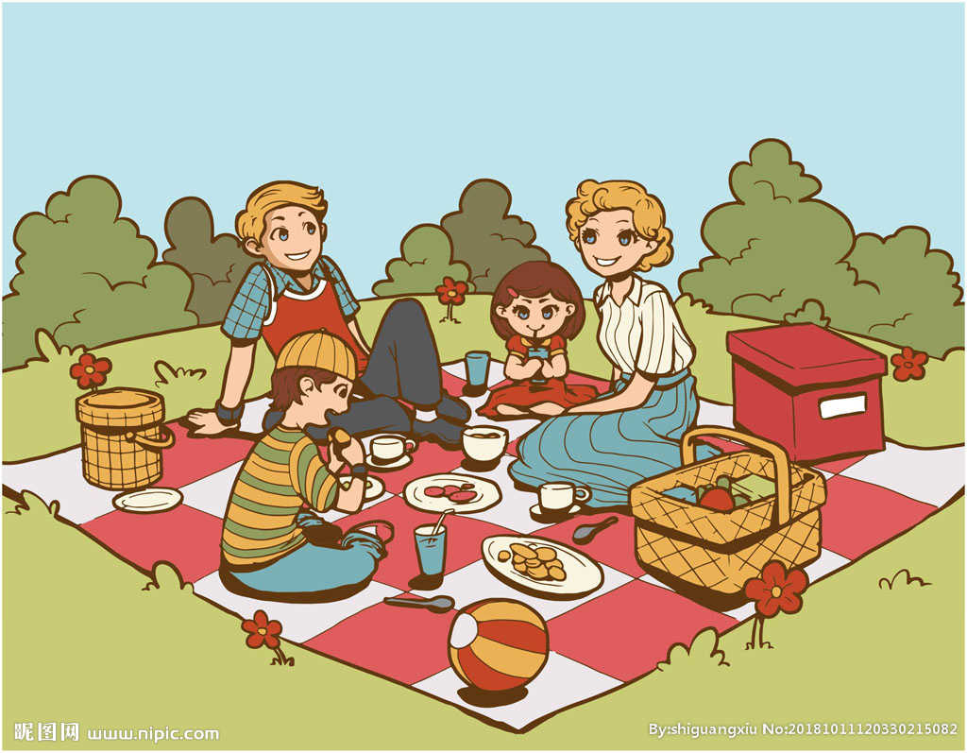

hadn’t rained
Special Usage 3
If + Subjunctive Mood
Yesterday | Today | Tomorrow
hadn’t rained
could have had
If it ________________ yesterday, we __________________ a picnic.
If it ________________ today, we __________________ a picnic.
If it ________________ tomorrow, we _________________ a picnic.
didn’t rain
could have
were to rain
could have

Slide 14
Special Usage 3
If + Subjunctive Mood
I. If our teacher wasn’t at school today...,
2. If I had worked harder, ...
3. If It were to snow tomorrow,...

Slide 15
Consolidate: 4 Special Usages of Modal verbs
can’t be/must be
can’t have done/must have done
1. Possiblility:
2. Subjunctive mood:
3. If+Subjunctive mood
should/ought to have done
could have done
Past:
Now:
Future

Slide 16
Let’s have a competition!
Choose a picture, talk about it with your group members.

Slide 17
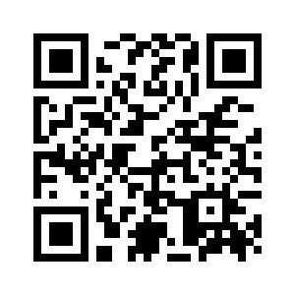
S
Exercises

Slide 18
Proverbs
There isn’t much “If” in our life, we must work hard now.
Don’t put off till tomorrow what should be done today.
今日事，今日毕。

Slide 19

Homework:
1. Finish exercise on Page25-27.
2. Preview Part3

Slide 20
Thanks for listening!
张家港中等专业学校 陈娟 2023.11

