Slide 1

苏教版 数学 三年级 下册
两位数乘整十位数的口算和估算
张家港市合兴小学 石榴

Slide 2




Slide 3


40×5
30×6
2×10
11×9
2×32
21×7
②
③
①
⑤
④
⑥

Slide 4

2×10
40×5
30×6
3×6=18
30×6=180
20
200
180
3个十
18个十
①
②
③
2×32
11×9
21×7
20×7=140
1×7=7
64
99
147
140＋7=147
④
⑤
⑥

Slide 5
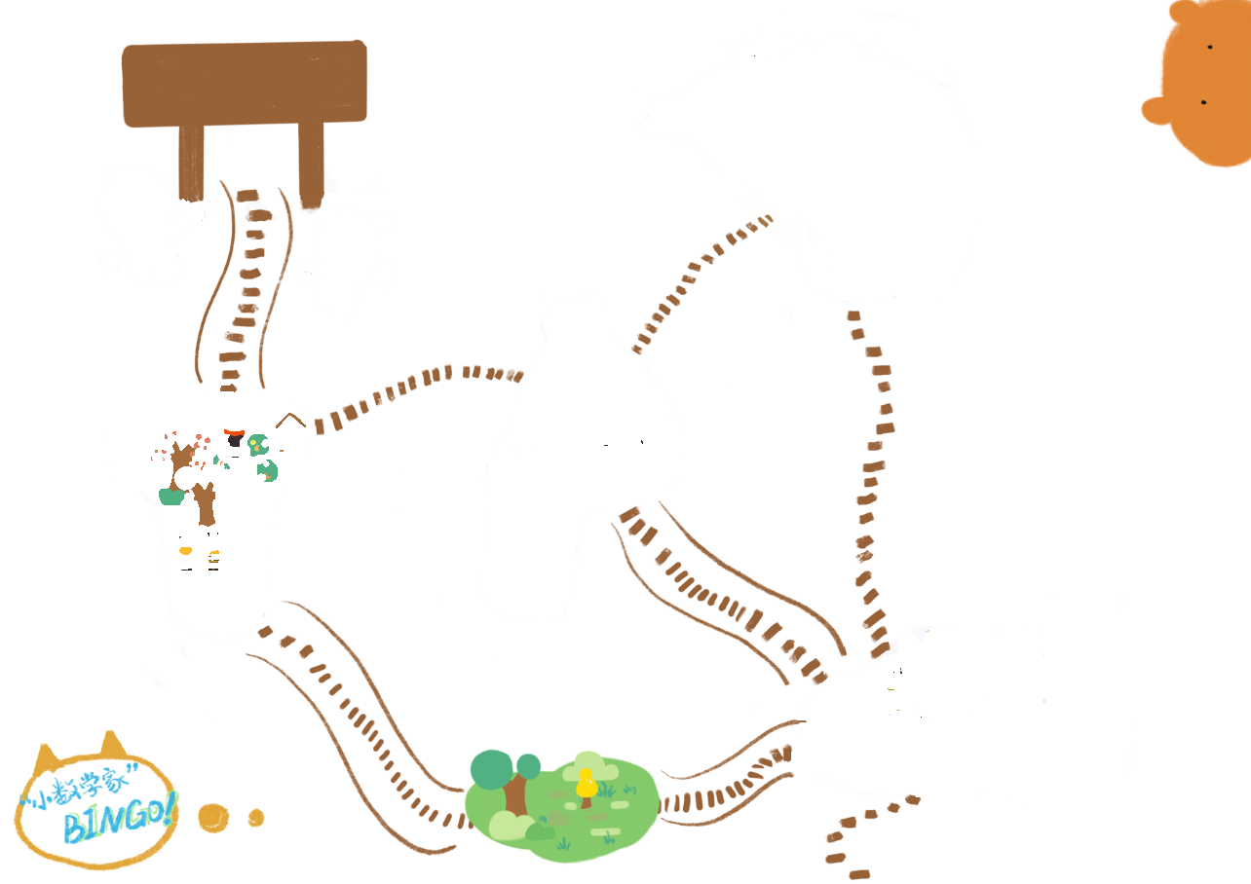

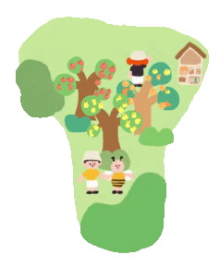
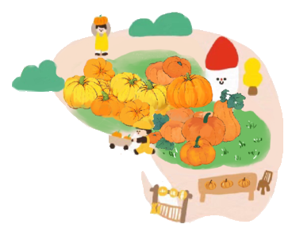
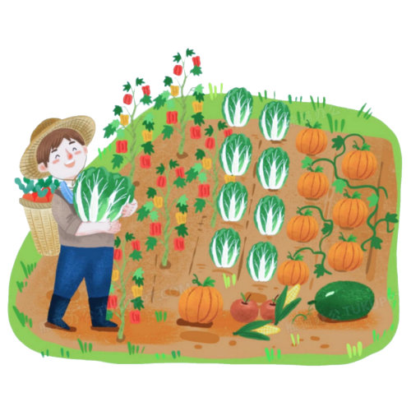
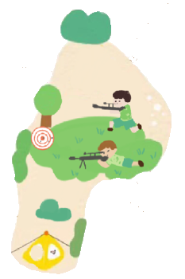
等你打卡
研学之旅
农耕园
百果园
南瓜园
蔬菜园
运动乐园

Slide 6
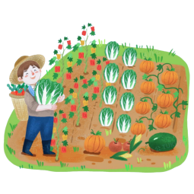
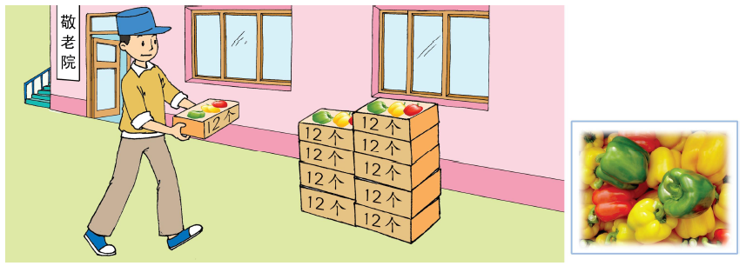




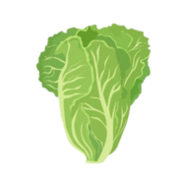
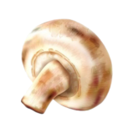
蔬菜园
李叔叔培育出一种新品种菜椒，打算送给敬老院10盒，每盒12个。
送给敬老院多少个？
8盒
5盒
9盒
5盒
12×10=

Slide 7

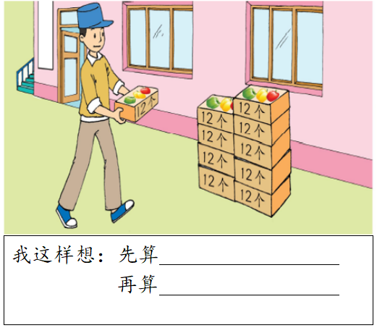
学习单1：

Slide 8
学习单2：
每盒12个
每盒12个
1
2
3
4
5
6
7
8
9
10
11
12
1
● | ● | ● | ● | ● | ● | ● | ● | ● | ● | ● | ●
● | ● | ● | ● | ● | ● | ● | ● | ● | ● | ● | ●
● | ● | ● | ● | ● | ● | ● | ● | ● | ● | ● | ●
● | ● | ● | ● | ● | ● | ● | ● | ● | ● | ● | ●
● | ● | ● | ● | ● | ● | ● | ● | ● | ● | ● | ●
● | ● | ● | ● | ● | ● | ● | ● | ● | ● | ● | ●
● | ● | ● | ● | ● | ● | ● | ● | ● | ● | ● | ●
● | ● | ● | ● | ● | ● | ● | ● | ● | ● | ● | ●
● | ● | ● | ● | ● | ● | ● | ● | ● | ● | ● | ●
● | ● | ● | ● | ● | ● | ● | ● | ● | ● | ● | ●
2
3
4
10盒
5
10盒
6
7
8
9
10

Slide 9

学习单2：
学习单1：
每盒12个
1
2
3
4
5
6
7
8
9
10
11
12
1
● | ● | ● | ● | ● | ● | ● | ● | ● | ● | ● | ●
● | ● | ● | ● | ● | ● | ● | ● | ● | ● | ● | ●
● | ● | ● | ● | ● | ● | ● | ● | ● | ● | ● | ●
● | ● | ● | ● | ● | ● | ● | ● | ● | ● | ● | ●
● | ● | ● | ● | ● | ● | ● | ● | ● | ● | ● | ●
● | ● | ● | ● | ● | ● | ● | ● | ● | ● | ● | ●
● | ● | ● | ● | ● | ● | ● | ● | ● | ● | ● | ●
● | ● | ● | ● | ● | ● | ● | ● | ● | ● | ● | ●
● | ● | ● | ● | ● | ● | ● | ● | ● | ● | ● | ●
● | ● | ● | ● | ● | ● | ● | ● | ● | ● | ● | ●
2
3
4
10盒
5
6
7
8
9
10

Slide 10
每盒12个
1
2
3
4
5
6
7
8
9
10
11
12
1
● | ● | ● | ● | ● | ● | ● | ● | ● | ● | ● | ●
● | ● | ● | ● | ● | ● | ● | ● | ● | ● | ● | ●
● | ● | ● | ● | ● | ● | ● | ● | ● | ● | ● | ●
● | ● | ● | ● | ● | ● | ● | ● | ● | ● | ● | ●
● | ● | ● | ● | ● | ● | ● | ● | ● | ● | ● | ●
● | ● | ● | ● | ● | ● | ● | ● | ● | ● | ● | ●
● | ● | ● | ● | ● | ● | ● | ● | ● | ● | ● | ●
● | ● | ● | ● | ● | ● | ● | ● | ● | ● | ● | ●
● | ● | ● | ● | ● | ● | ● | ● | ● | ● | ● | ●
● | ● | ● | ● | ● | ● | ● | ● | ● | ● | ● | ●
2
3
4
5
12×5=60（个）
6
10盒
60×2=120（个）
7
8
9
10

Slide 11
蔬菜园
李叔叔培育出一种新品种菜椒，打算送给敬老院10盒，每盒12个。
送给敬老院多少个？
12×10=

Slide 12


等你打卡
研学之旅
农耕园
百果园
南瓜园
蔬菜园
运动乐园

Slide 13

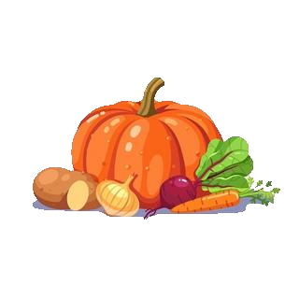

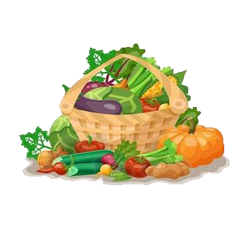
16×1=
16
12×2=
24
20×3=
60
16×10=
0
0
0
0
160
12×20=
240
20×30=
600
24个十
60个十
南瓜园

Slide 14
20
2×3=6
0
00
20×30=600
30
0
2个十
3个十
6个百

Slide 15

等你打卡
研学之旅
农耕园
百果园
南瓜园
蔬菜园
运动乐园

Slide 16
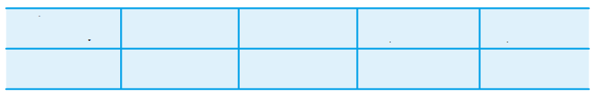
王大伯把收获的橘子装在同样大的筐子里，一共装了60筐。为了估算总产量，他从中任意抽出5筐称一称，结果如下表：
同样大
任意
第一筐
第二筐
第三筐
第四筐
第五筐
按每筐30千克估算
28千克
31千克
31千克
29千克
33千克
王大伯大约一共收获橘子多少千克？
30×60=1800（千克）
答：大约一共收获橘子1800千克。

Slide 17

等你打卡
研学之旅
农耕园
百果园
南瓜园
蔬菜园
运动乐园

Slide 18

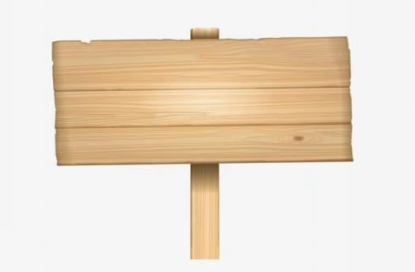
运动乐园

Slide 19


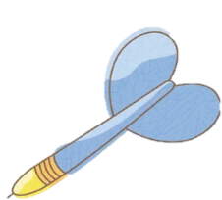


20×14=
280

Slide 20


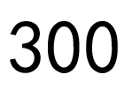
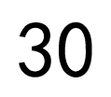
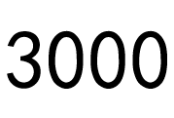


60×50=
3000

Slide 21

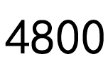
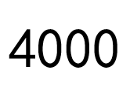
58×80≈
4800

Slide 22
等你打卡
研学之旅
农耕园
百果园
南瓜园
蔬菜园
运动乐园

Slide 23
……
……
12×10=12020×30=120
两位数乘整十数
2×32=64
21×7=147
两位数乘一位数
20×3=60
200×3=600
整十、整百数乘一位数
2×3=6
表内乘法

Slide 24
谢谢！

